Slide 1
Measuring Recursive Resolver Centrality
Geoff Huston, Joao Damas
APNIC Labs

Slide 2
Why pick on the DNS?
The DNS is used by everyone and everything
  Because pretty much everything you do on the net starts with a call to the DNS
  If a single entity “controlled” the DNS then to all practical purposes they would control not just the DNS, but the entire Internet!

Slide 3
This Presentation
What’s the problem with centrality anyway?
What does centrality in the DNS mean?
How to measure DNS centrality
What we measure
What are we see

Slide 4
Centrality
Many aspects of the Internet’s infrastructure are operated by fewer and fewer entities over time

Slide 5
What’s the problem?
Economics A01 (or Adam Smith’s Invisible Hand)
  Competition rewards efficient producers
  Innovation that increases production efficiency is rewarded
  Consumers benefit from increased production efficiency and innovation
Consolidation in the market
  Distorts the functions of an open competitive market
  Decreases competition pressure
  Creates barriers to entry in the market
  Reduces pressure for increased production efficiency and innovation
  Consumers end up paying a premium

Slide 6
Consolidation in the DNS
It’s not a new topic:
  For many years Bind was a defacto monopoly provider for DNS software. At the time every DNS recursive resolver and authoritative server ran Bind software. This has broadened out to a number of software platforms and is less of a concern today
Where else might we find consolidation in today’s DNS?
  Name Registration services
  Name Hosting service providers
  Name Resolution providers

Slide 7
Focus!
Here we are going to concentrate on just one of these areas!
We will look at the recursive resolver market and try to understand the extent to which we are seeing consolidation of the recursive name resolution function

Slide 8
Recursive Resolvers
This function is generally bundled with an ISP’s access service for public network services
  Which means that there is already some level of consolidation in this space as the concentration of these DNS services follows the concentration of ISPs in the retail market
Is there consolidation in the DNS recursive resolution function over and above this access market consolidation?
Where might we see such consolidation?

Slide 9
The Rise of Open DNS Resolvers
There are some 6M open DNS resolvers in operation today* Most of these appear to be inadvertently open due to errant CPE equipment
Others are explicitly configured to offer DNS resolution services as a open service
  Hard to say where all this started, but an early example was the the 4.2.2.2 open resolver project offered by BBN Planet in the mid-90’s, though there were many others even then
    At that time many ISPs used recursive resolvers as a service and some operated these platforms as a open service as a least cost / lowest admin overhead option
  The use of anycast in the DNS made it possible to operate a single service with a distributed footprint
  Open DNS was one of the early offerings of a dedicated recursive resolution service with a scaled up infrastructure
  Google Public DNS entered the picture with a service that took scaling to the next level
* https://scan.shadowserver.org/dns/

Slide 10
What’s the Centrality Question here?
One way to measure centrality is by “market share”
So the question here would be:
  What proportion of users of the Internet use <X> as their DNS resolver?
  We won’t distinguish between end users explicitly adding their own DNS configuration into their platform and ISPs using forwarding structures to pass all DNS queries to an open resolver. Through the lens of “centrality” both paths to using open DNS resolvers look the same!

Slide 11
How we Measure DNS Centrality
We use Google Ads as the main element of this measurement
  The measurement script is an embedded block of HTML5 code in an Ad
  The Ad runs in campaigns that generate some 10M impressions per day
  We get to “see” the DNS in operation from the inside of most mid-to-large ISPs and service providers across the entire Internet
Ads provide very little functionality in the embedded scripts – it’s basically limited to fetching URLs
  But that’s enough here, as a URL fetch involves the resolution of a domain name
  So we use unique DNS names in every ad, so the DNS queries will be passed though to our authoritative servers

Slide 12
Recursive Resolver Behaviours
The task is to match the source of a query of a domain name to both a resolver and an end user
We need to
  map query IP source addresses to resolvers
  understand how the DNS “manages” queries
  how the resolver lists in /etc/resolv.conf are used

Slide 13
Mapping Resolver Addresses
We use periodic sweeps with RIPE Atlas to reveal the engine addresses used by popular Open DNS resolvers, and load this into an identification database

Slide 14
Understanding Resolver Behaviour
Resolver Engine
Service Address
Resolver Engine
Query Distributor
From Client
Resolver Engine
Resolver Engine
Engine Address
To Server

Slide 15
Resolution Metrics
Average query count per unique name: 3.4
  (Dual stack hosts may be a factor here)
  Max observed query count in 30 seconds is 1,761 queries!

Slide 16
Resolution Metrics
Average number of resolvers (IP addresses) per unique name: 2.1
30 second maximum resolvers seen: 94

Slide 17
First Resolver vs Full Resolver Set
What happens if the authoritative server always reports SERVFAIL to all queries?
We use a server that always returns a SERVFAIL error code to prompt the client to run through its full set of recursive resolvers

Slide 18
SERVFAIL Resolution Metrics
Average query count per unique name: 36.5
  Max observed query count in 30 seconds is 292,942 queries!

Slide 19
SERVFAIL Resolution Metrics
Average number of resolvers (IP addresses) per unique name: 8.9
30 second maximum resolvers seen: 1,368

Slide 20
Recursive Resolver Stats
Of the 140,000 visible recursive resolvers, just 150 resolvers account for 20% of all users and 1,500 resolvers account for 50% of all users.
10,000 resolvers account for 90% of all users
However we are looking here at resolver IP addresses, and that’s probably misleading.
Lets try and group resolver IP addresses into resolver services

Slide 21
Recursive Resolver Stats
Of the 14,600 visible recursive resolvers services, just 15 resolver services serve 50% of users
250 resolver services serve 90% of users
Is this what we mean by “centralisation”?

Slide 22
Details
Lets break this data down into:
  Using a “known” open DNS resolver
  Using a resolver in the same AS as the user
  Using a resolver in the same country as the user
  Others

Slide 23
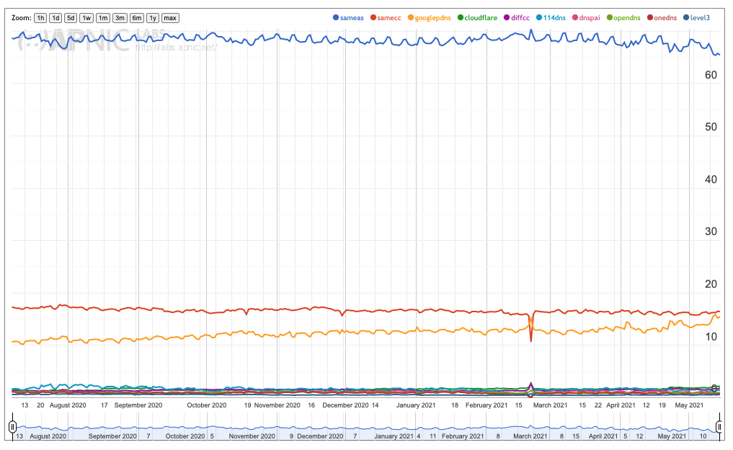
”First” Resolver Use
70% of users use a resolver located in the same AS as the user (ISP resolver)
17% of users use a resolver located in the same CC as the user (ISP resolver?)
15% of users use the Google open resolver (8.8.8.8)

Slide 24
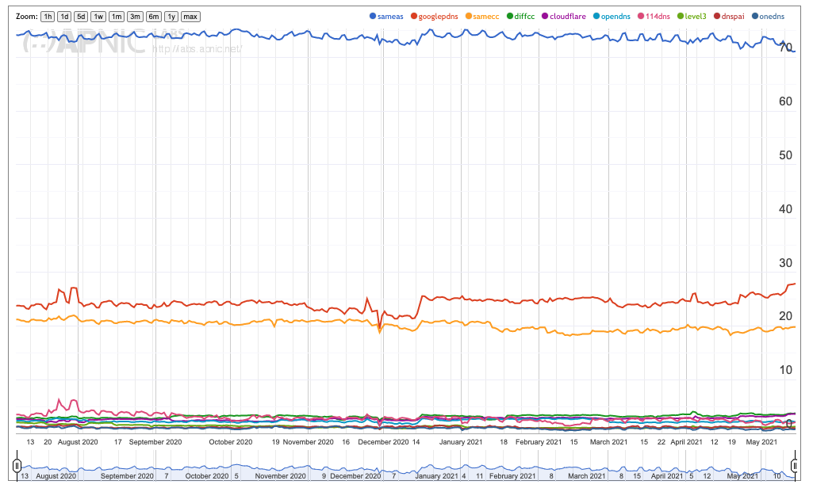
All Resolver Use (SERVFAIL)
70% -> 72% for same ISP
15% -> 29% for Google use
(yes, the plotting software performed a colour change – sorry!)

Slide 25
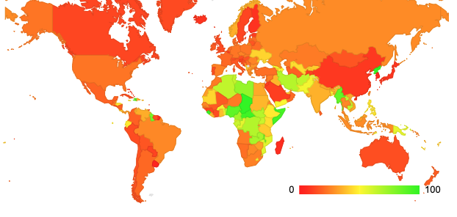
Google DNS
Use of Google Service per CC
Within each country how many users
In that country use Google’s resolver?

Slide 26
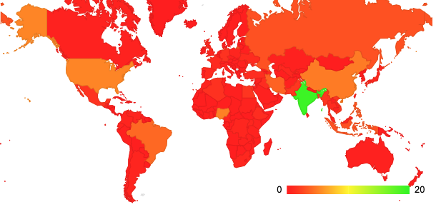
Google DNS
Use of Google Service by User Count
Looking at the total population of users using Google’s service, where are they located?

Slide 27
Google DNS
Google DNS use appears to be equally split between first use (15% of users) and backup resolvers (a further 14% of users)
Within each economy Google DNS is heavily used in some African economies, and central and southern Asian economies
The largest pool of Google DNS users are located in India (19% of Google DNS users)
Significant pools Google users are also seen in the US, China, Nigeria, Brazil and Iran (each CC has some 4% - 6% of Google’s DNS users)

Slide 28
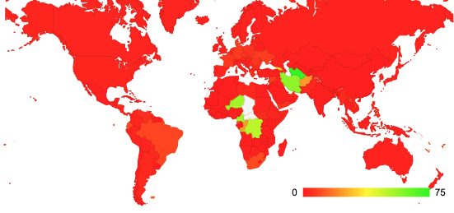
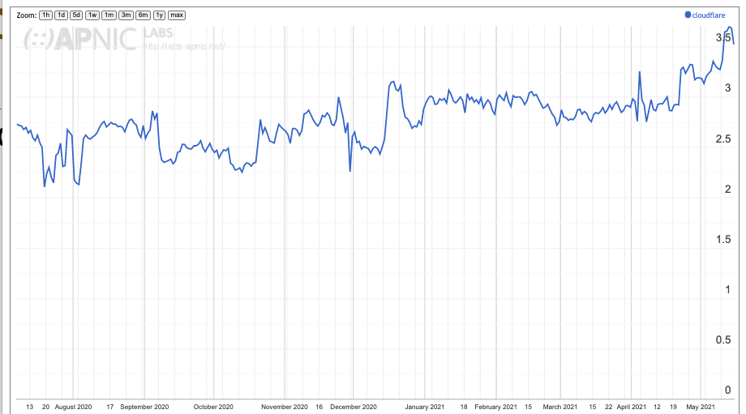
Cloudflare’s 1.1.1.1 service
Where is Cloudflare used?
Cloudflare market share
Cloudflare is extensively used in Turkmenistan (80%), Iran (57%), Niger (54%) Cameroon (54%) and the Congo (49%)

Slide 29
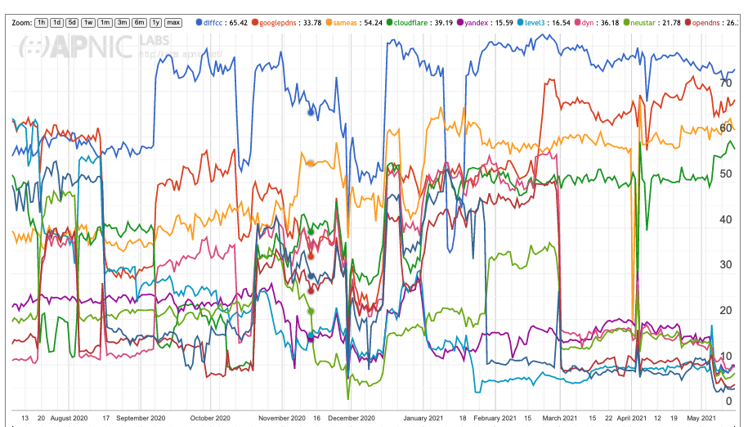
Iran
A major ISP in IRAN, MCCI, distributes its queries across Google, Cloudflare, Yandex, Neustar, OpenDNS, Quad9 and others

Slide 30
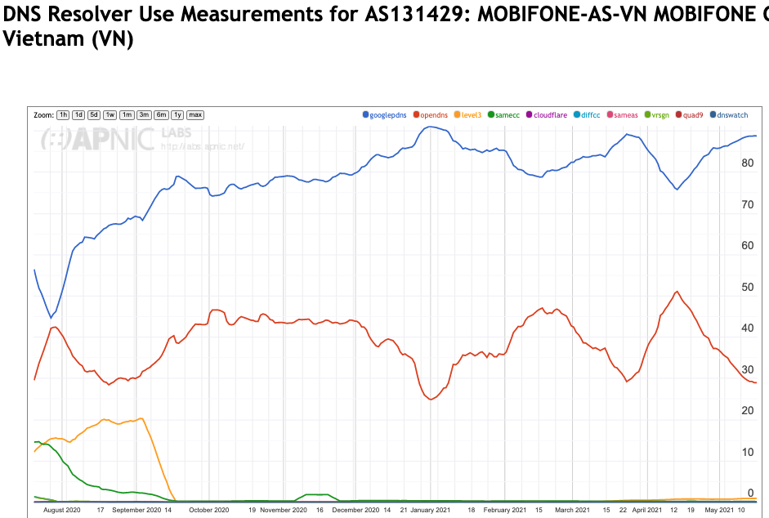
Who makes the choice?
Is this the ISP‘s resolver performing forwarding of the query to an open resolver, or the users themselves opting out of the ISP service?
  The numbers vary, but it is quite common to see 60% - 80% of users in an AS having their queries sent to an open resolver when open resolvers are used
Google DNS at 86%
Open DNS at 27%

Slide 31
Resolver Centrality?
Its not a “small number” of open resolvers
  It’s just 1 – Google’s Public DNS
Its not end users reconfiguring their devices
  It’s the ISP
  And where its not the ISP it’s mainly enterprise customers of ISPs
Is this changing?
  Yes, but quite slowly

Slide 32
Is this a “problem”?
It this an emerging distortion of the market that puts excessive market control in the hands of a small set of providers?
  No, not so far
It’s more likely that the shift of DNS functions into application realms using DoH services as an application function is a far greater threat to the current model of the DNS as a common single infrastructure

Slide 33

Thanks!
Report on Resolver Use: https://stats.labs.apnic.net/rvrs

