Slide 1

Are we there yet?
IPv6 in 2016
Geoff Huston
APNIC

Slide 2
A question to each of you…

Slide 3

A question to each of you…
How many IPv6 presentations have you sat through?

Slide 4
A question to each of you…
How many IPv6 presentations have you sat through?
20?
100?
1,000?
I don’t know!

Slide 5
A reminder
In case you weren’t paying attention at the time, here’s a few extracts from my archives…

Slide 6

14 years ago, in China

Slide 7
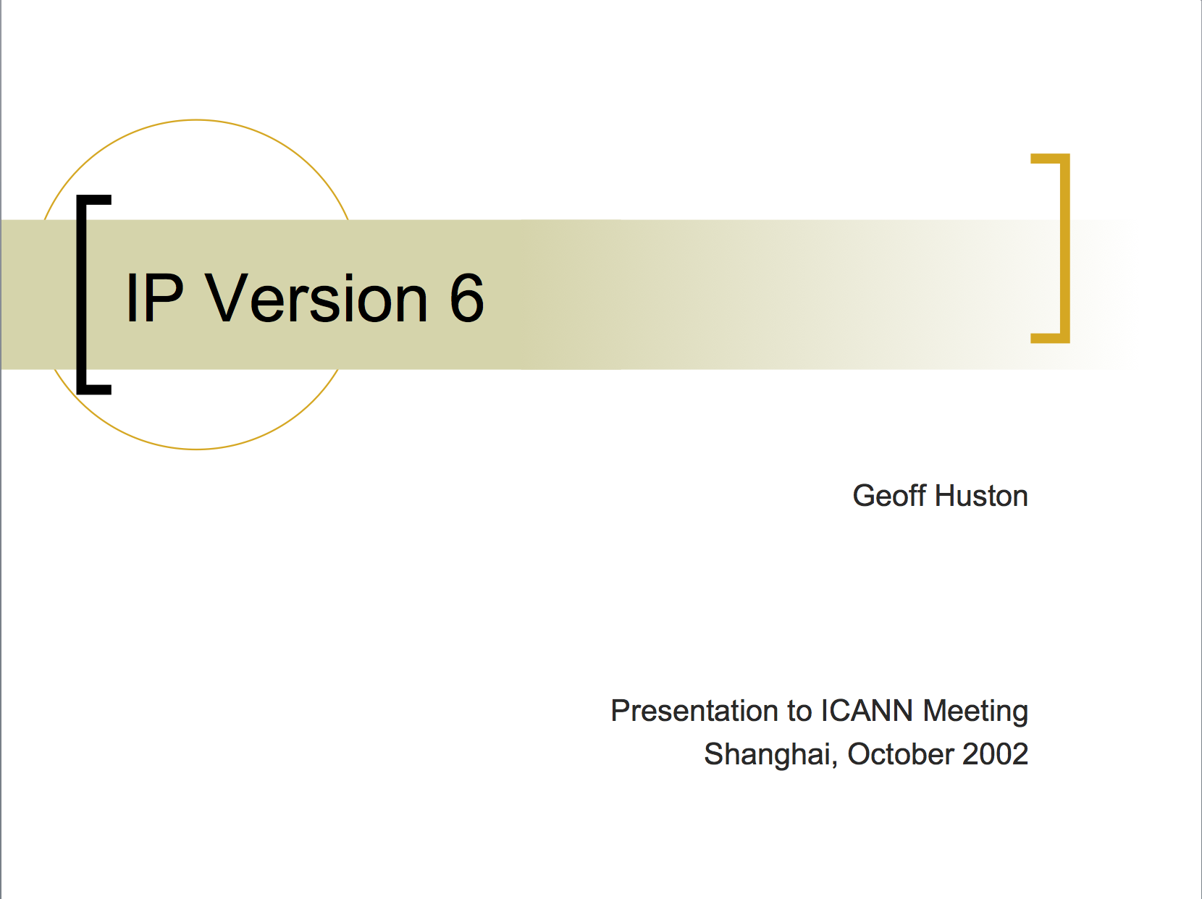
14 years ago, in China

Slide 8
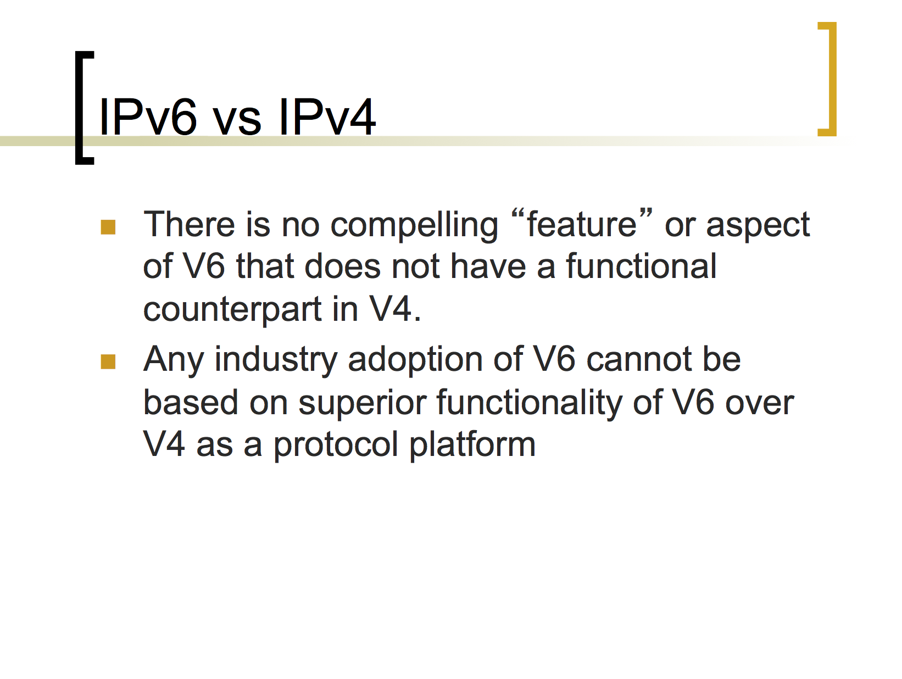
On IPv6 Myths
IPv6 is not brighter, shiner, or more miraculous. It just has more addresses!

Slide 9
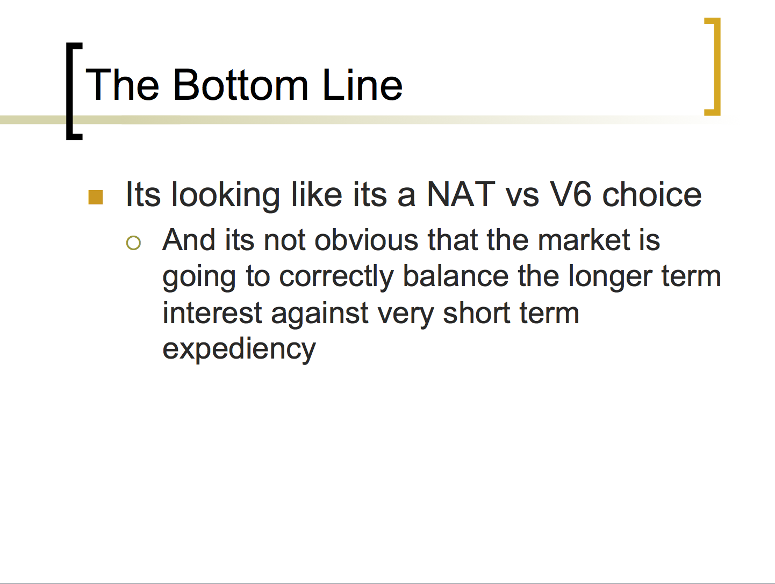
Wavering in the ranks!
Moments of doubt and uncertainty!

Slide 10

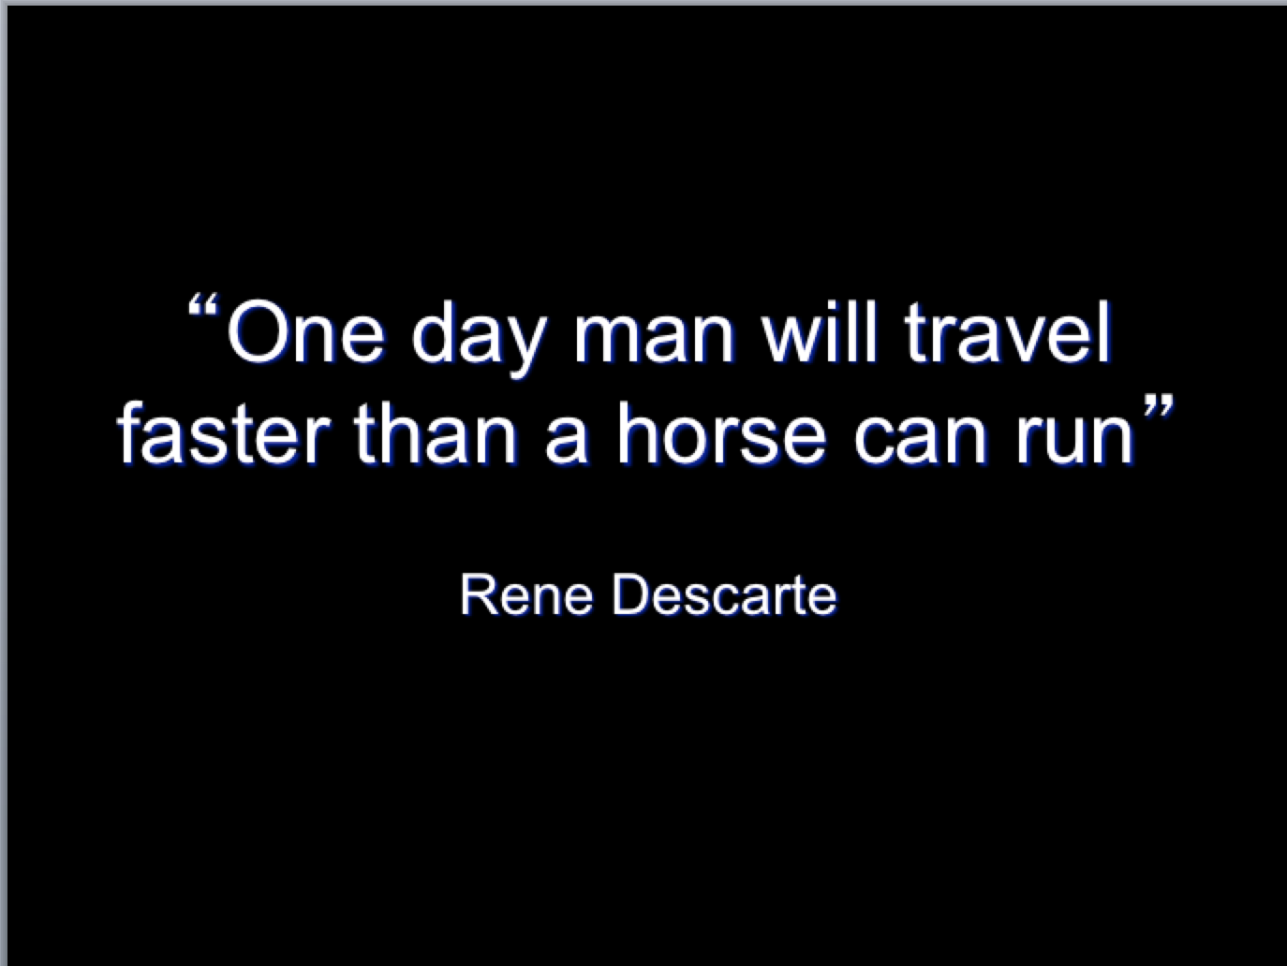
2005:
If this is all about guessing future requirements, then sometimes we
can be both right and incredibly wrong at the same time!
Photo Credit: Flickr: Jessica Cross: Horse Racing at Mornington
https://www.flickr.com/photos/jesscross/3169240519/in/photolist-5Q4bMV-4gyhvJ-Gvc5k-34jvvH-5XiMpu-Jb5hm-eXiyxv-2ajyQ-6fscj8-32N5HE-JdpwB-aCcUB-8q2wVx-8q2xPx-8v83iE-Ht4go-63qFi2-HfF2U-8JUCPk-797TPo-7942S4-7943A8-5hTPuQ-5hTPew-E3Vzr-5XiKxU-6iJ21P-5HF7SH-Ht4gj-6iNcFs-6yLEYT-8uaFep-5Xew1T-8uaG1i-8q5tMJ-fpqkrQ-4gyrbf-i9Bra-8q2Ake-8q5HLs-2aayTQ-8v7YPq-Ht4gb-NyKJM-5dgGTX-5bWSxq-5dgRoz-5bWVWQ-7942q6-7942sn/

Slide 11
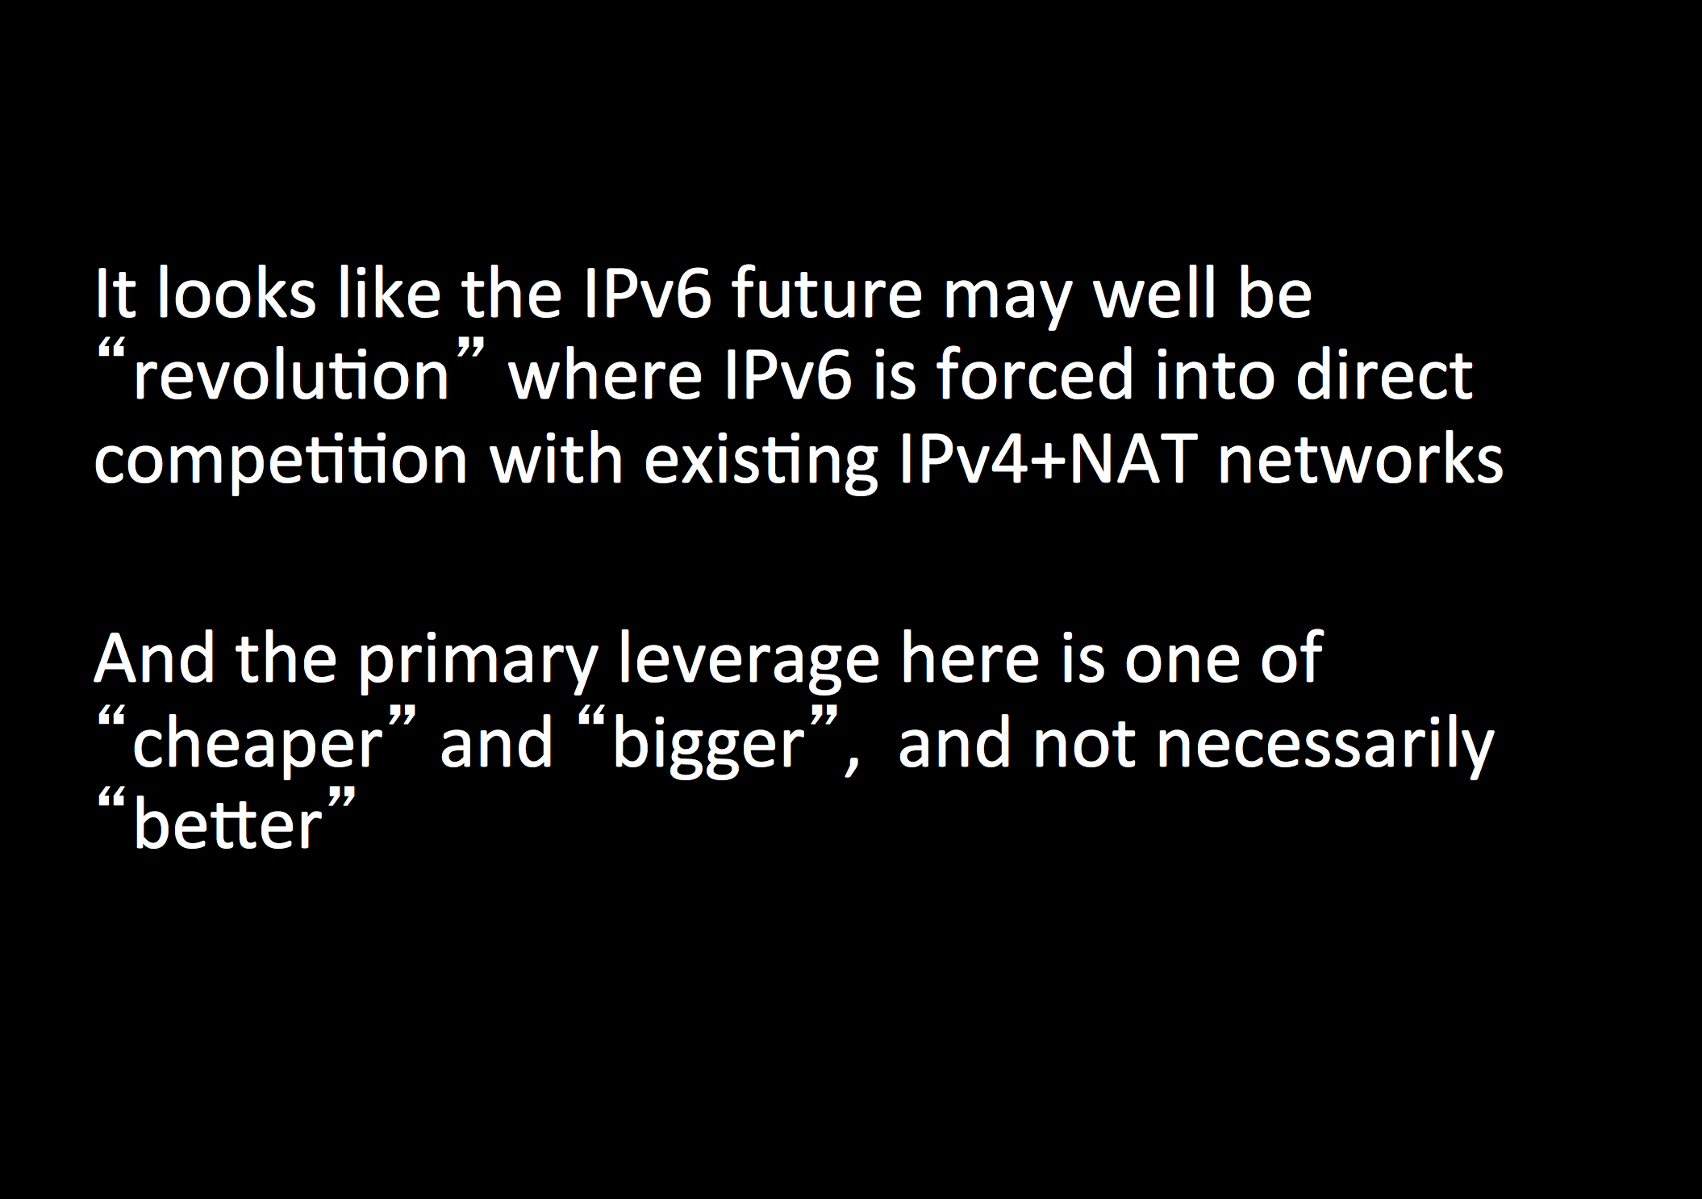
2005: Redefining terms of engagement
The emerging realization that IPv6 won’t just happen in the same way that IPv4 just happened -- there are other factors at play here.

Slide 12
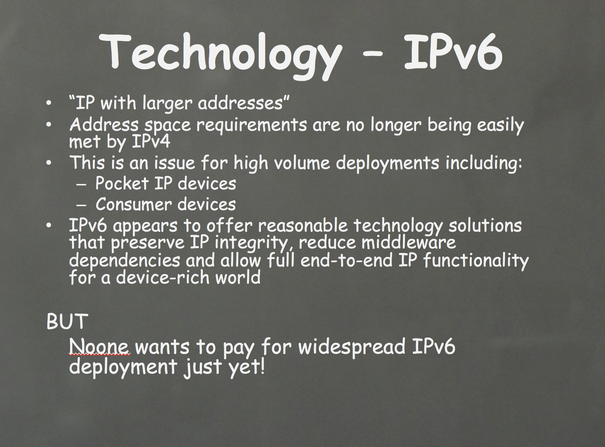
2006:
Searching for drivers for IPv6 adoption

Slide 13
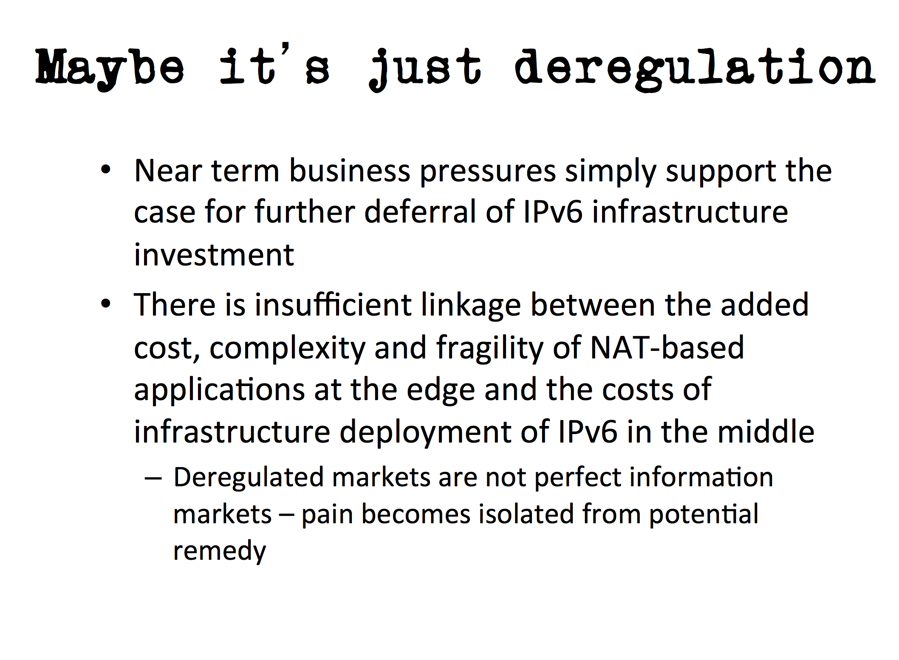
2007:
It’s not just a technology issue – there are business drivers here as well

Slide 14
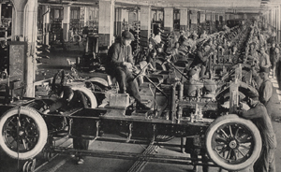
2008:
New Markets for IPv6?
The Universe of Tiny Things?
  The world of billions of chattering devices unleashing new rivers of gold into the IP industry?
    Or is this just the economy? There is no new money and these billions of chattering devices will generate much the same revenue as we have today
      So we have to cram all these billions of new devices trillions of new packets into the same money that we have today.
        technology leverage will make tomorrow’s networks 1,000 times CHEAPER to deliver an IP packet than today’s network?
Or have we reached some limit to the economic viability of communications that imply that ever smaller valued transactions can’t be sustained over ever larger networks?
Do RFID and Bluetooth provide a different model of communication that is viable in the universe of things, where the identity is global but the communication is strictly limited in scope and
And if you ever are curious enough to enlarge this slide to see if there is text all the way down the page you will have got yourself to this point, where it becomes obvious that I’ve got nothing more to say and I want to fill up the bottom of the slide with tiny text.

Slide 15
2008
This is the time of the “IPv4 exhaustion is coming. What are we going to do?”
presentations.
Lets dive into one of them for a few slides from 2008…

Slide 16
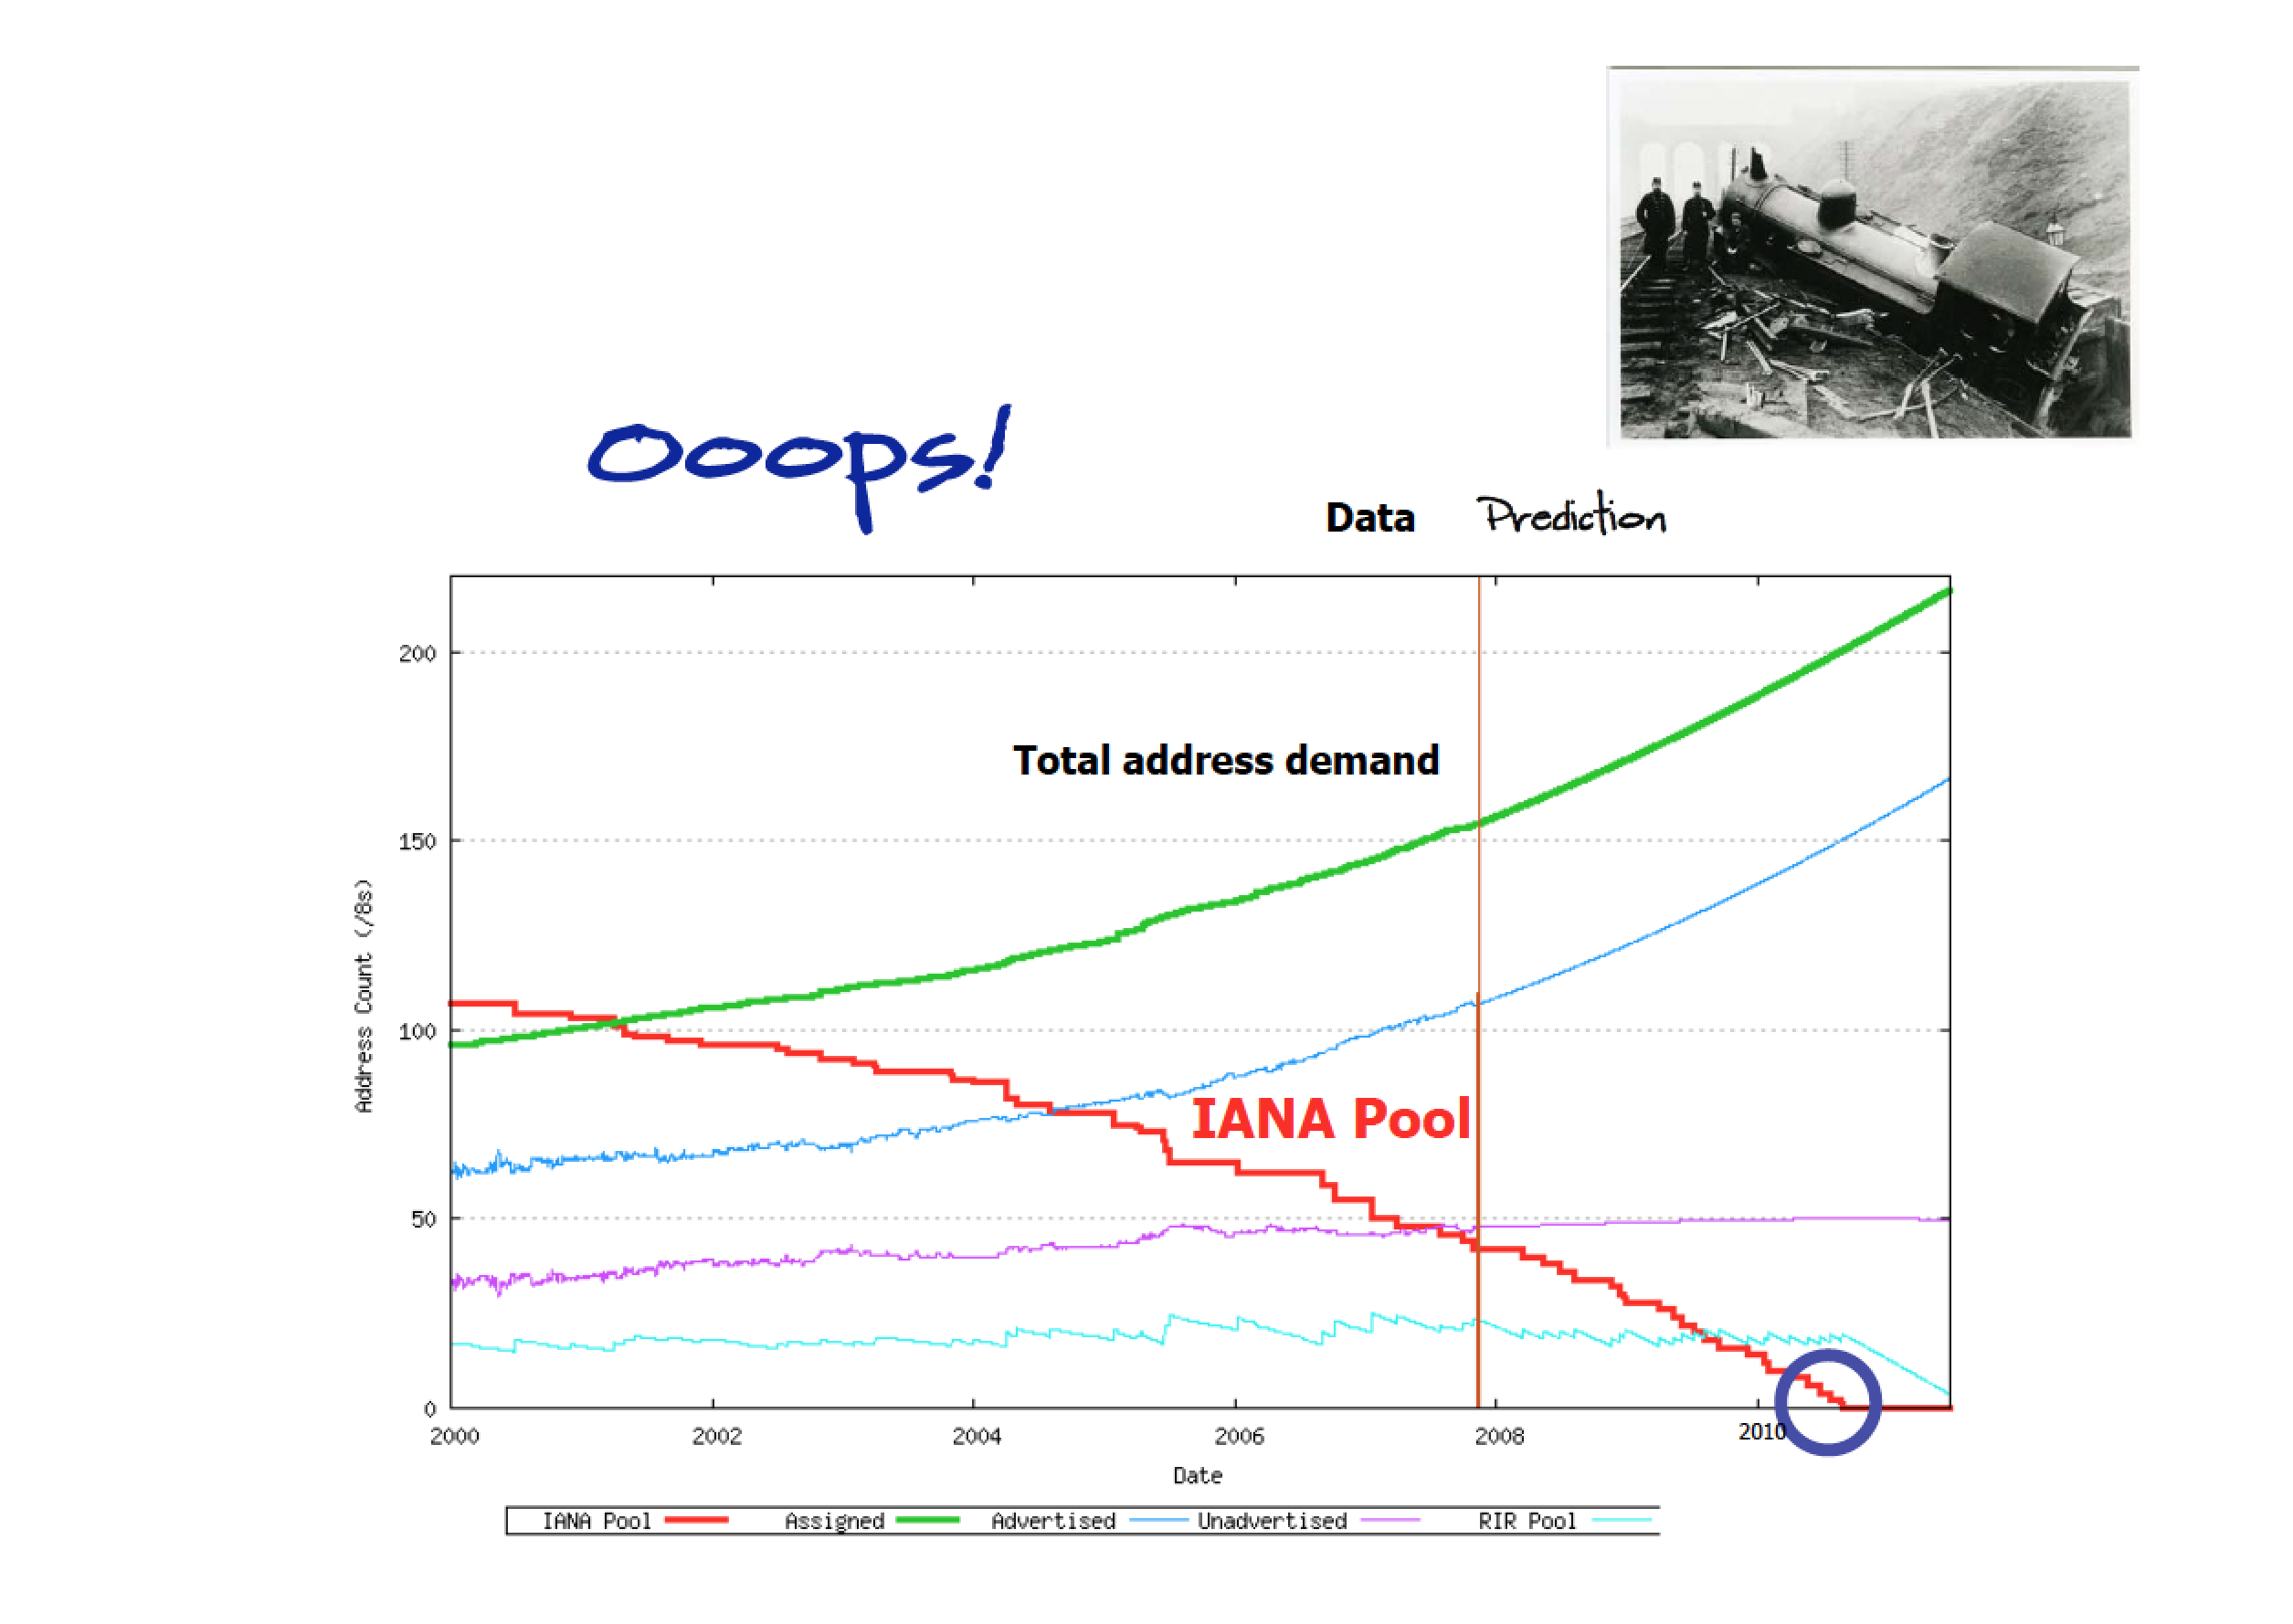

Slide 17


Slide 18


Slide 19
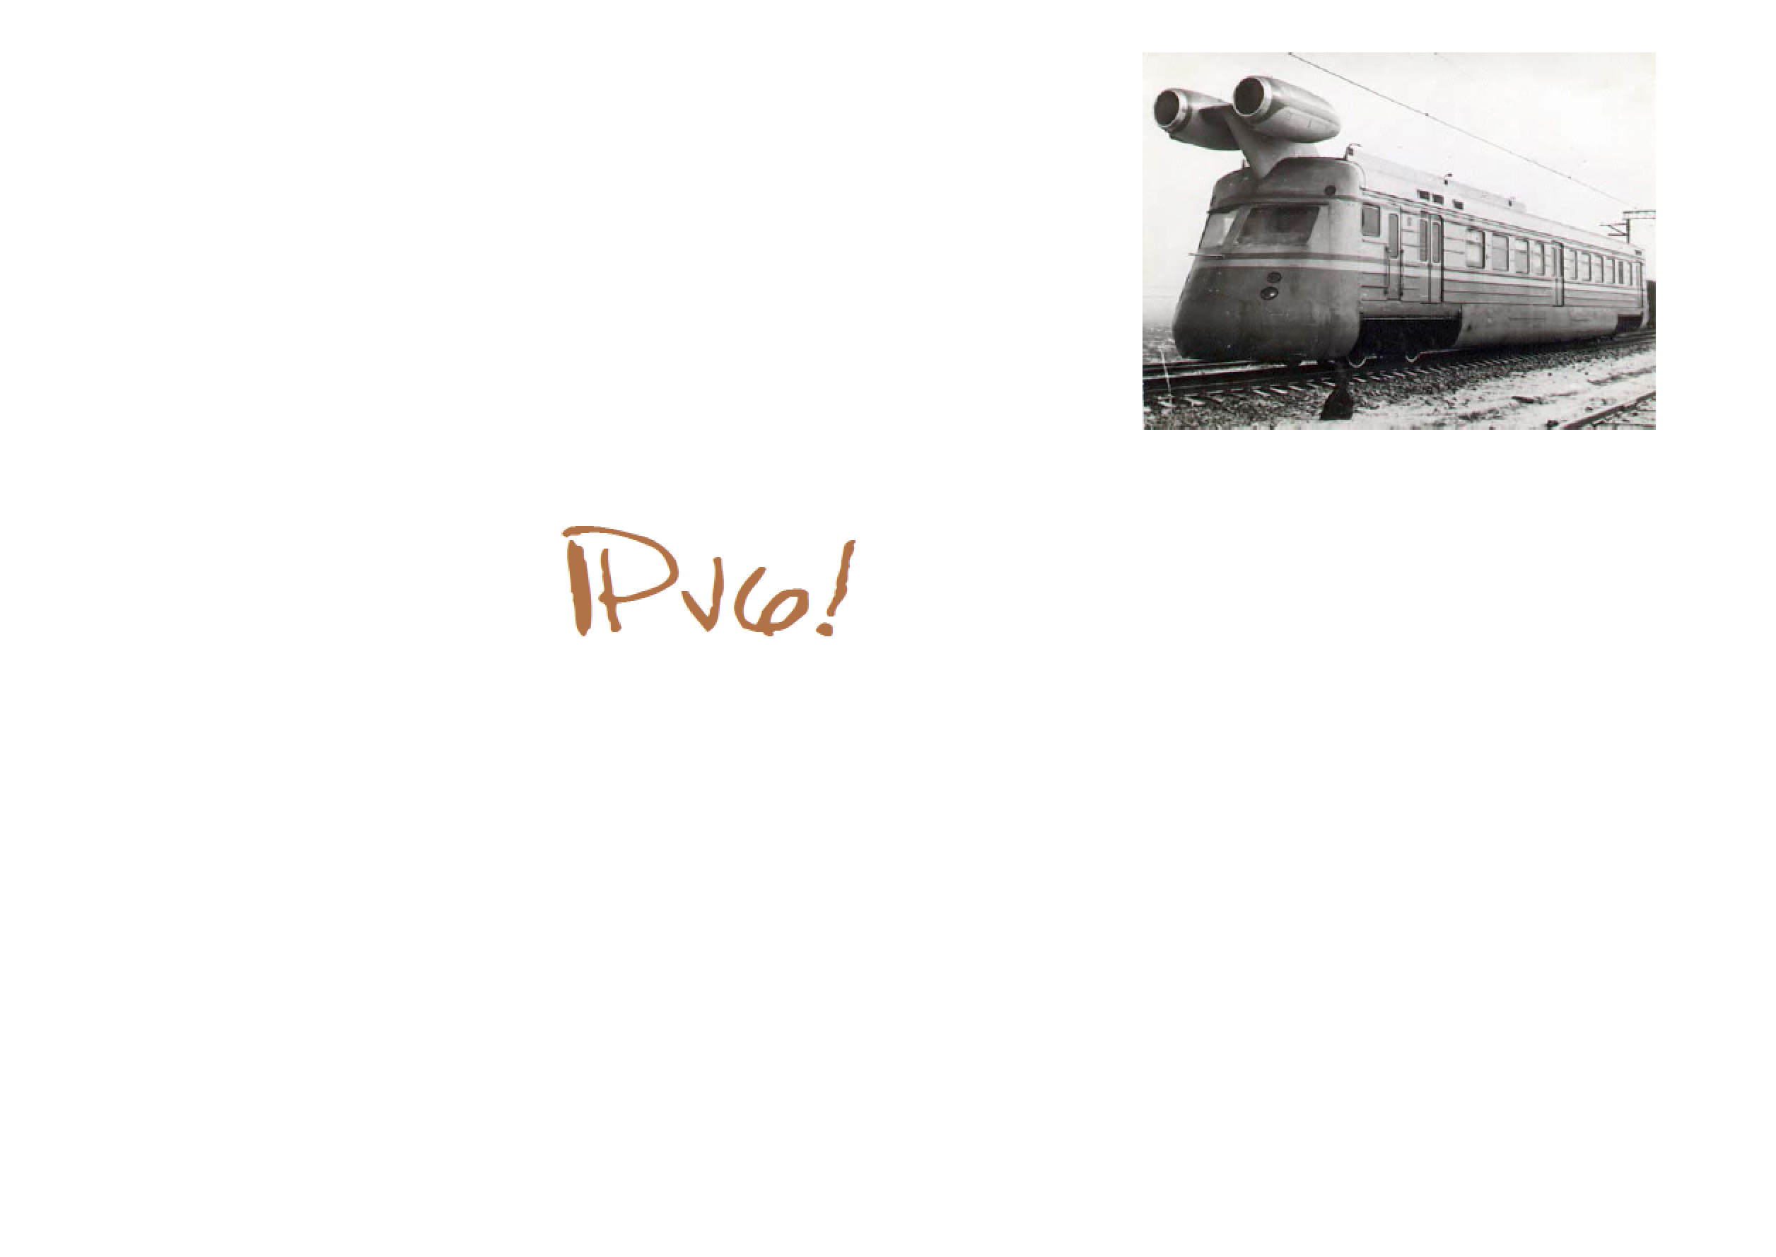

Slide 20
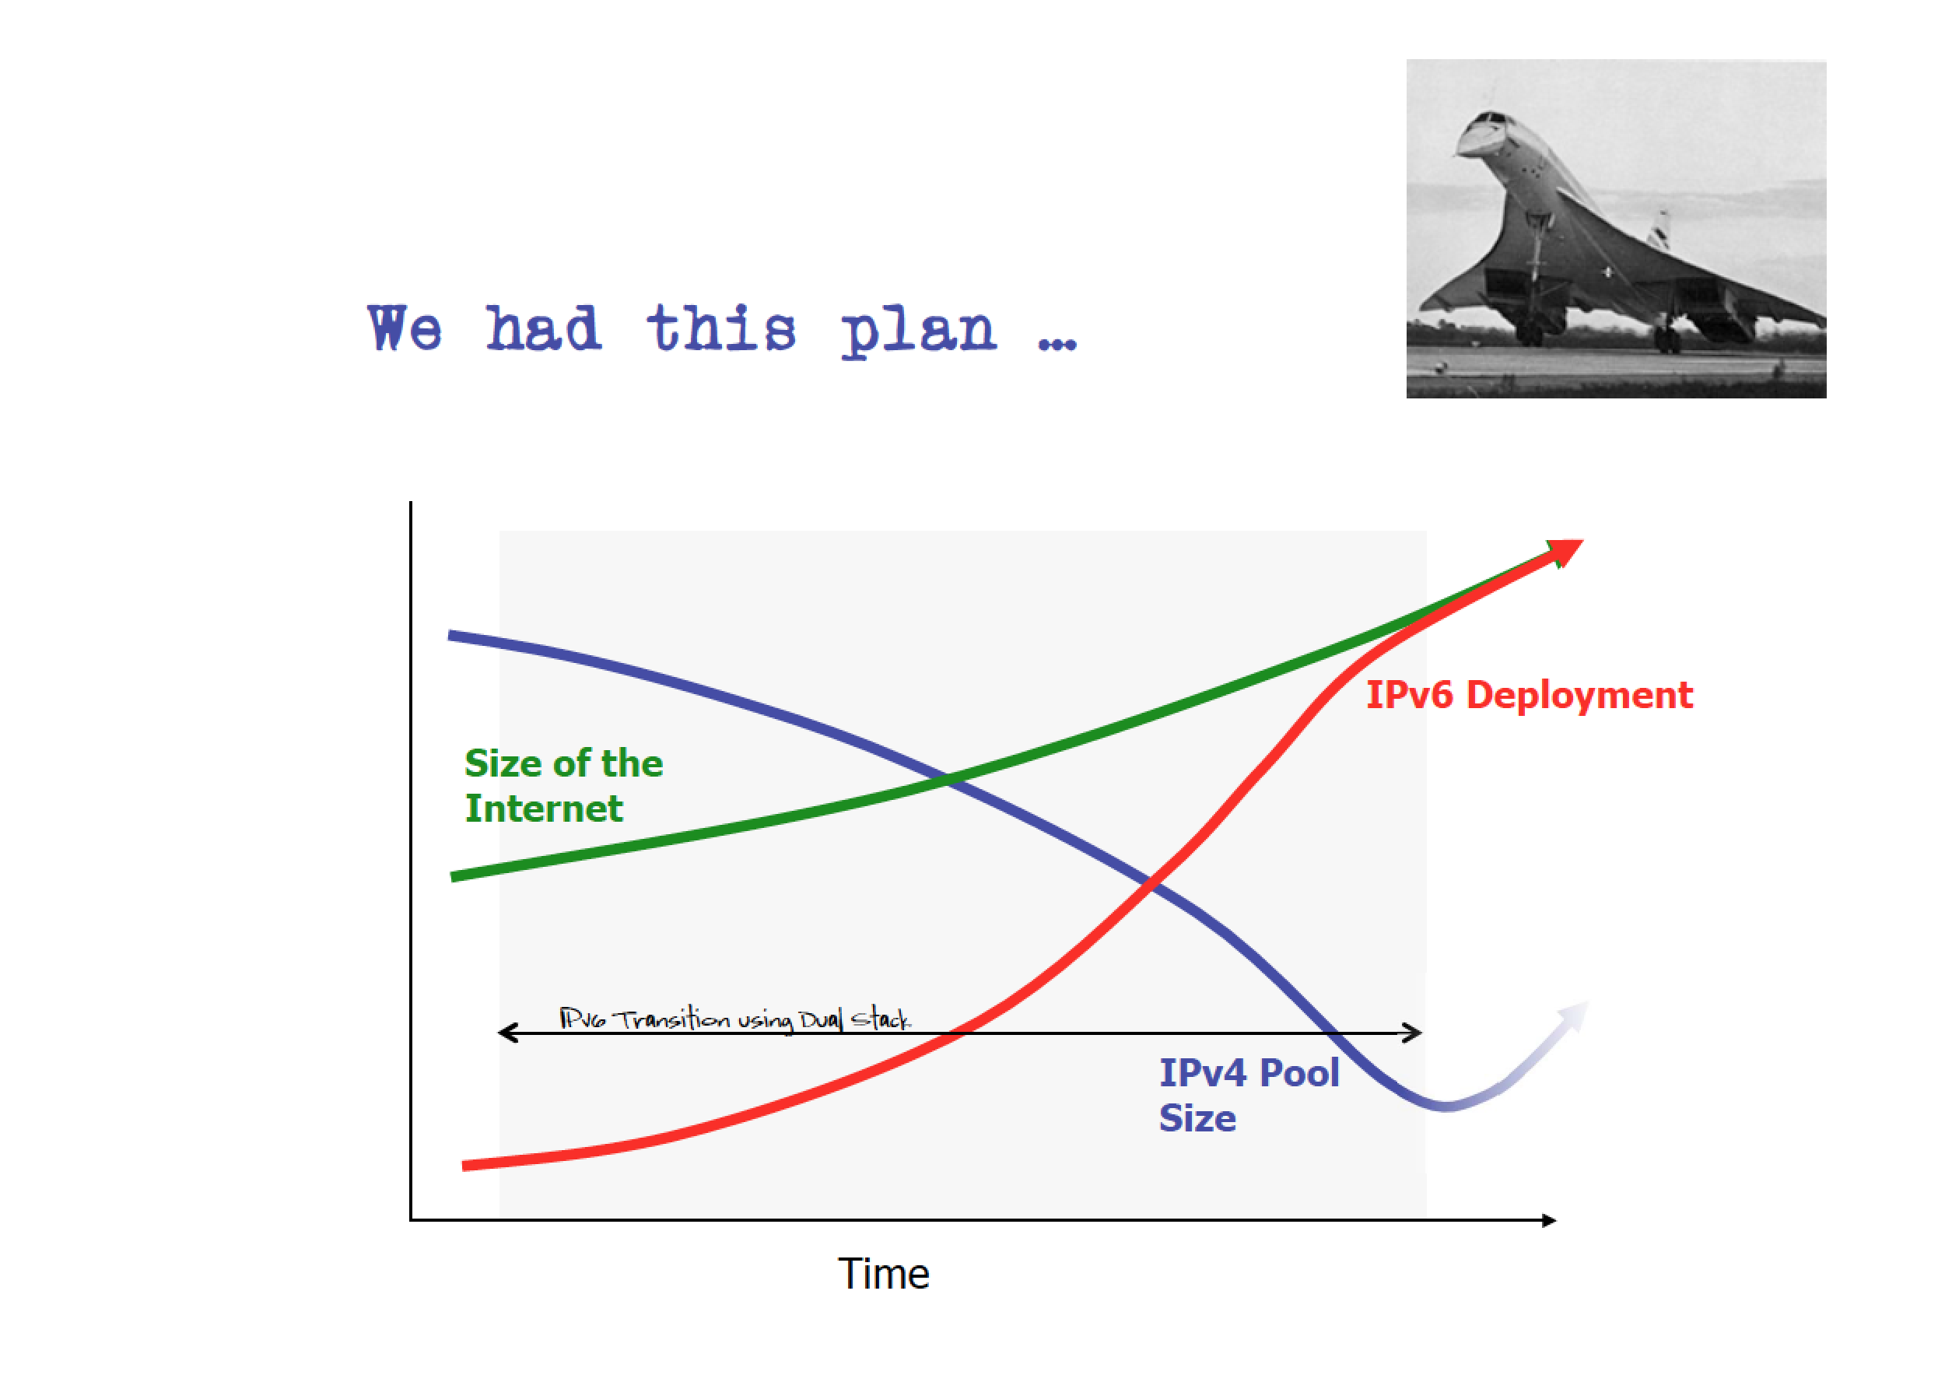

Slide 21
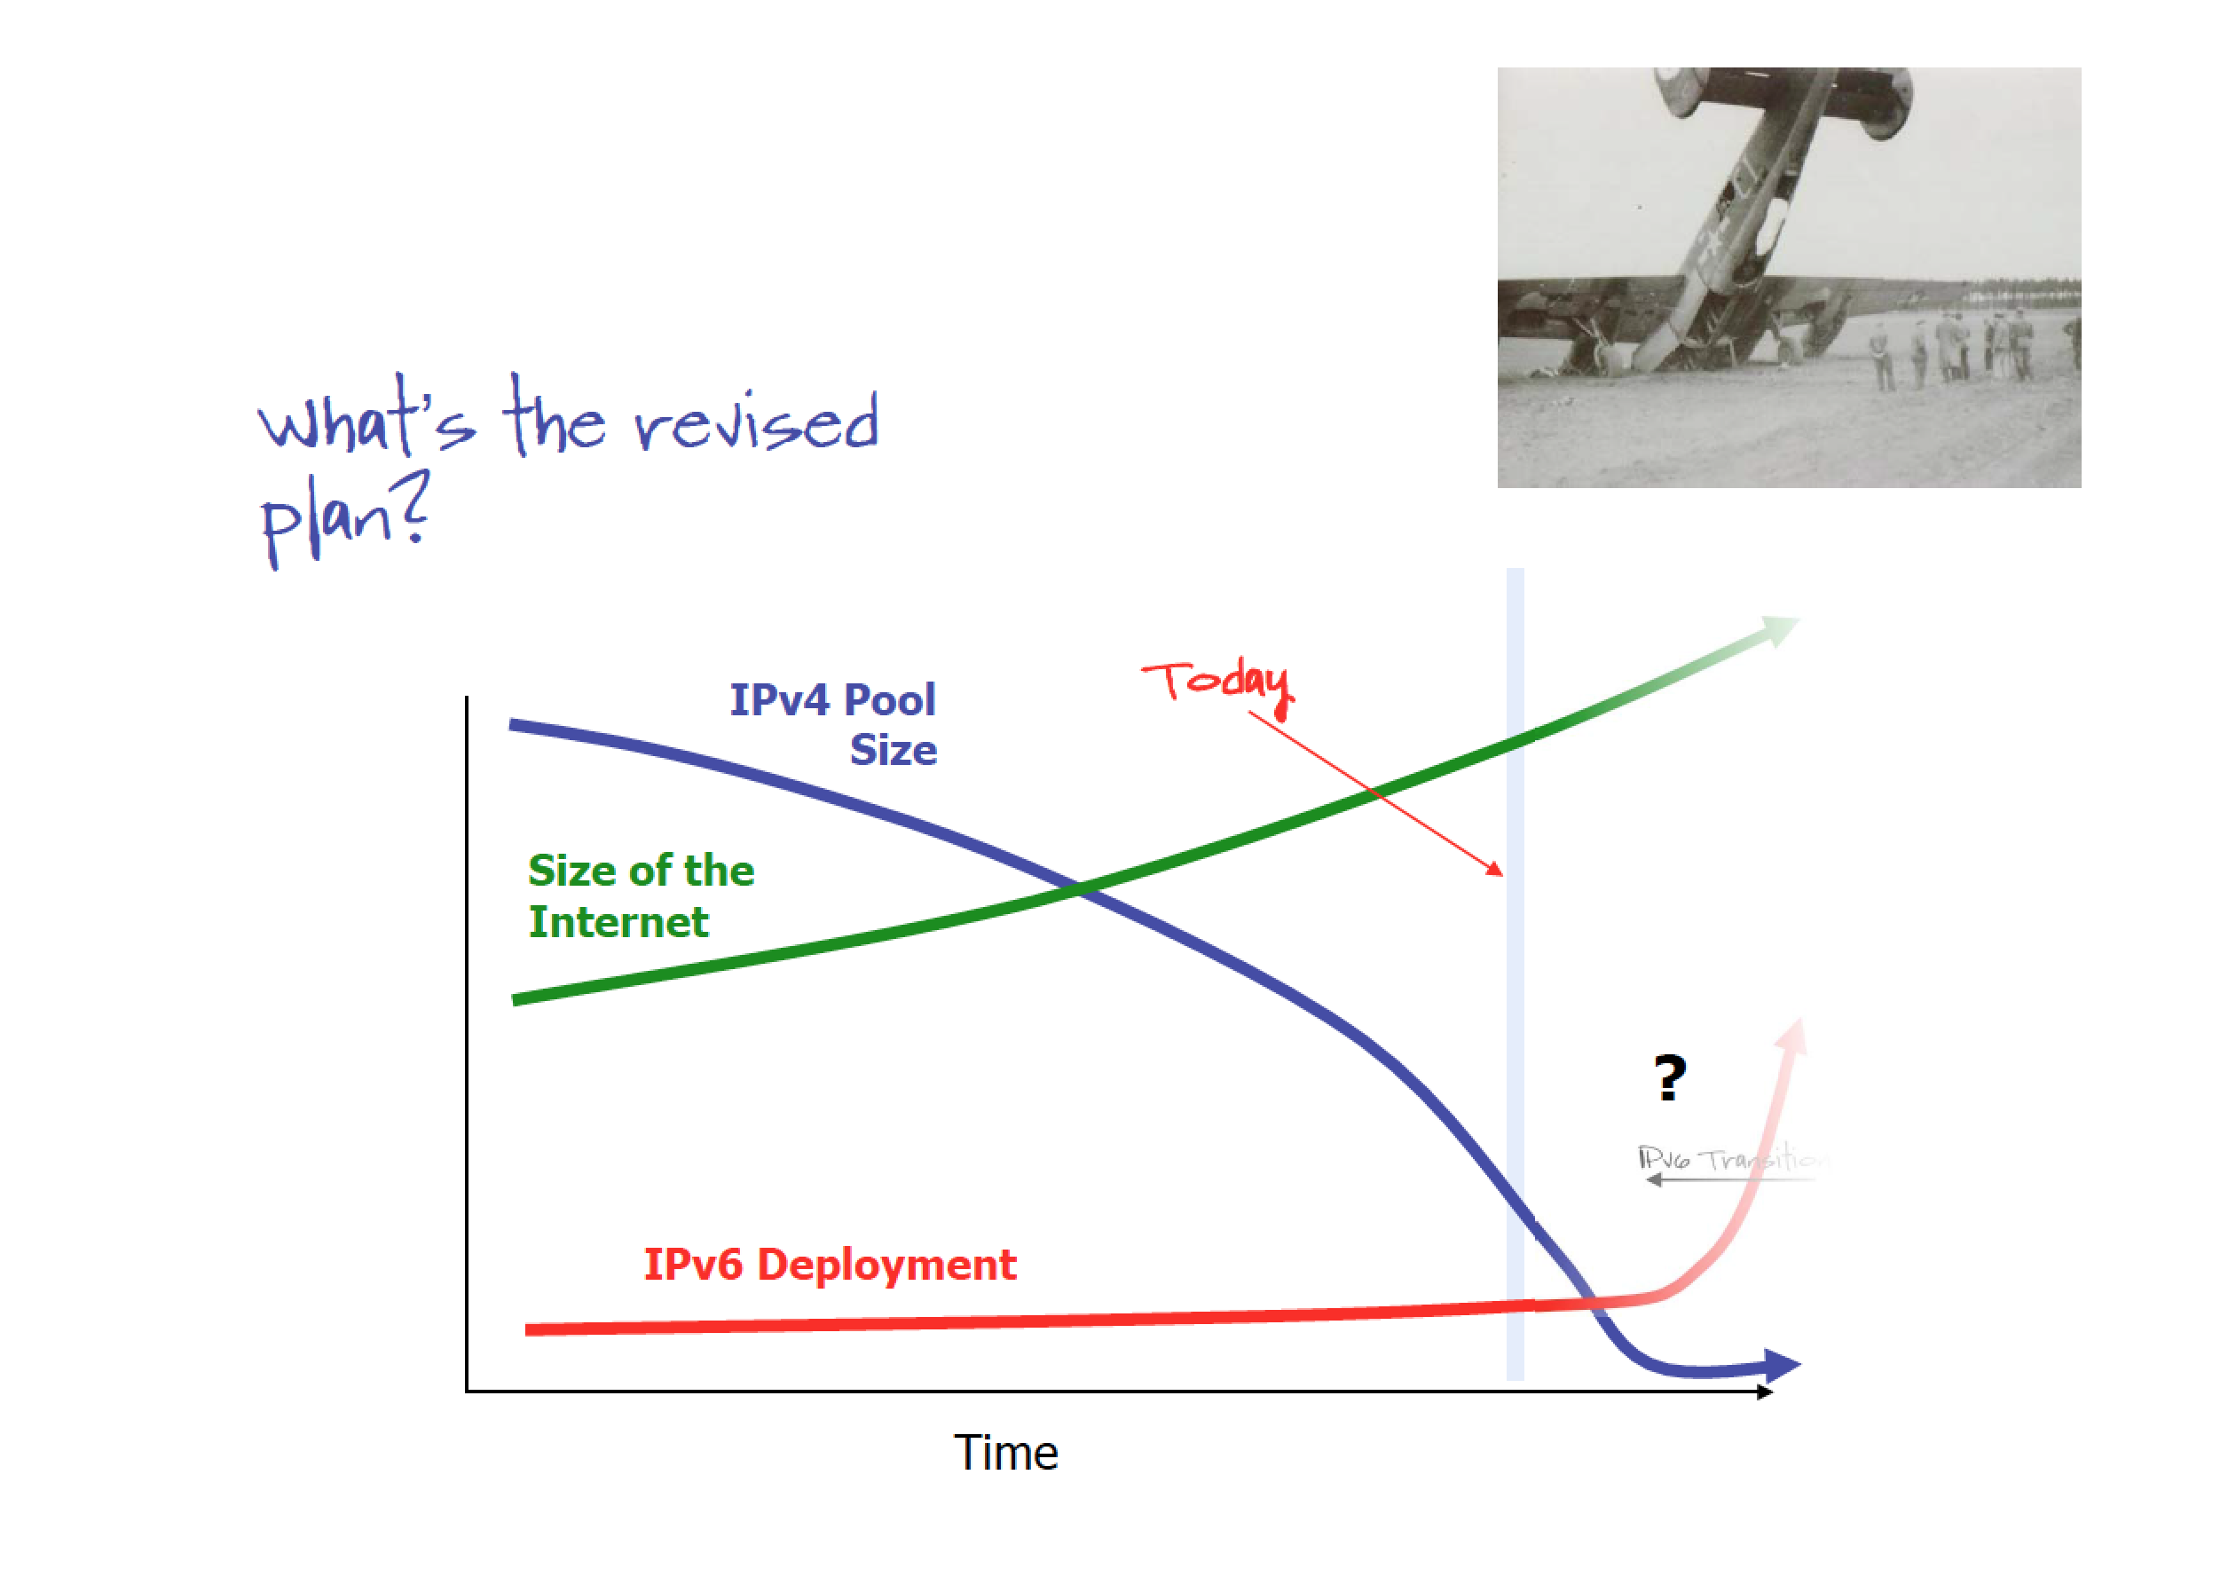

Slide 22
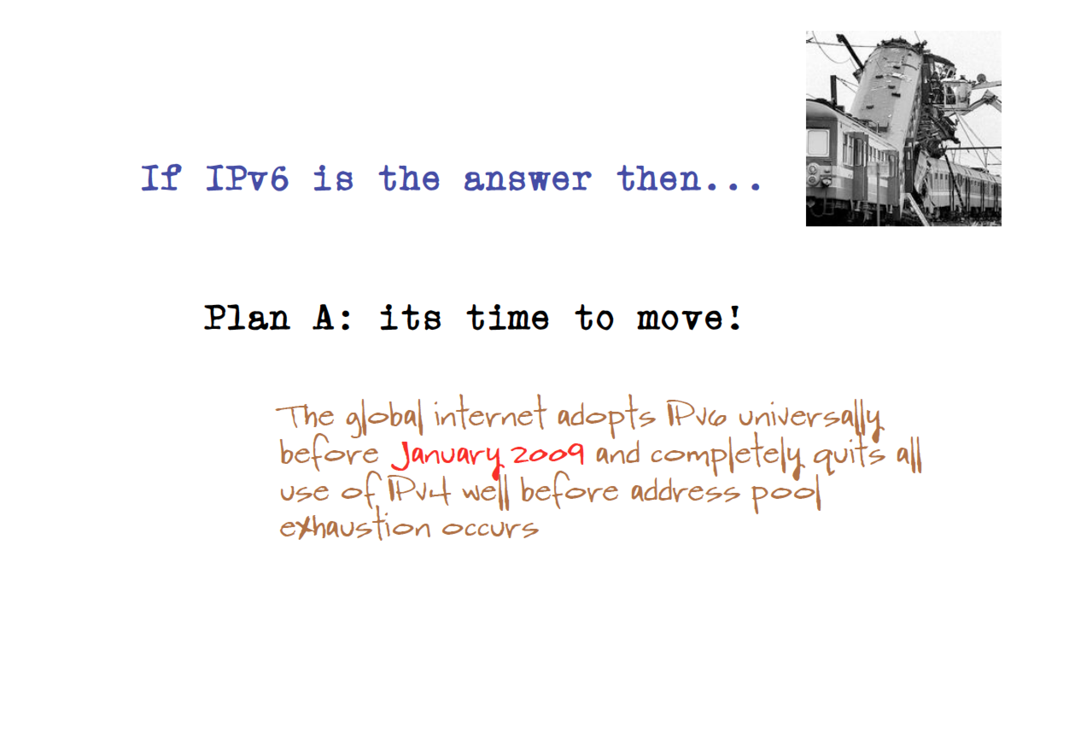

Slide 23
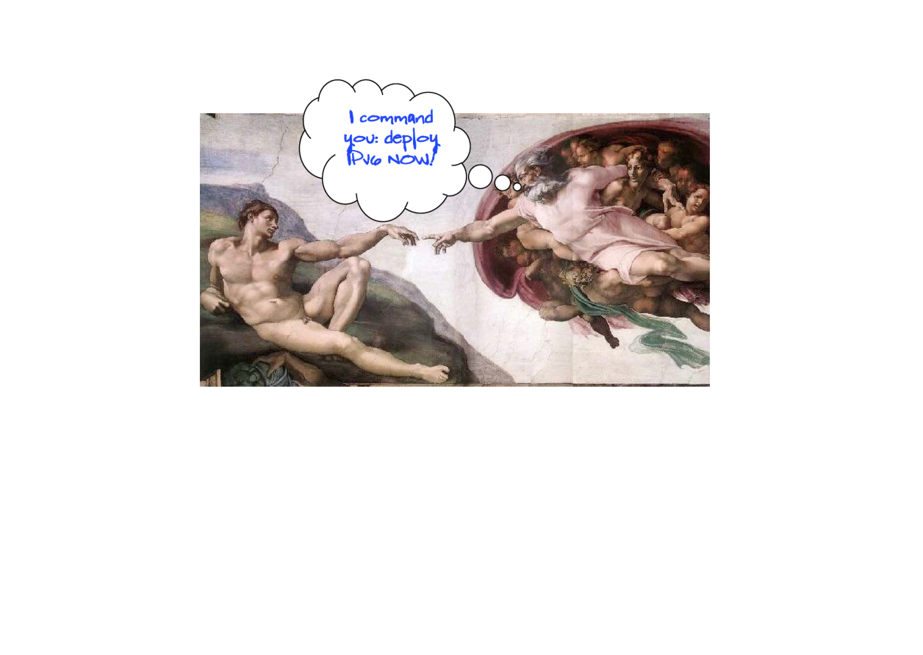

Slide 24
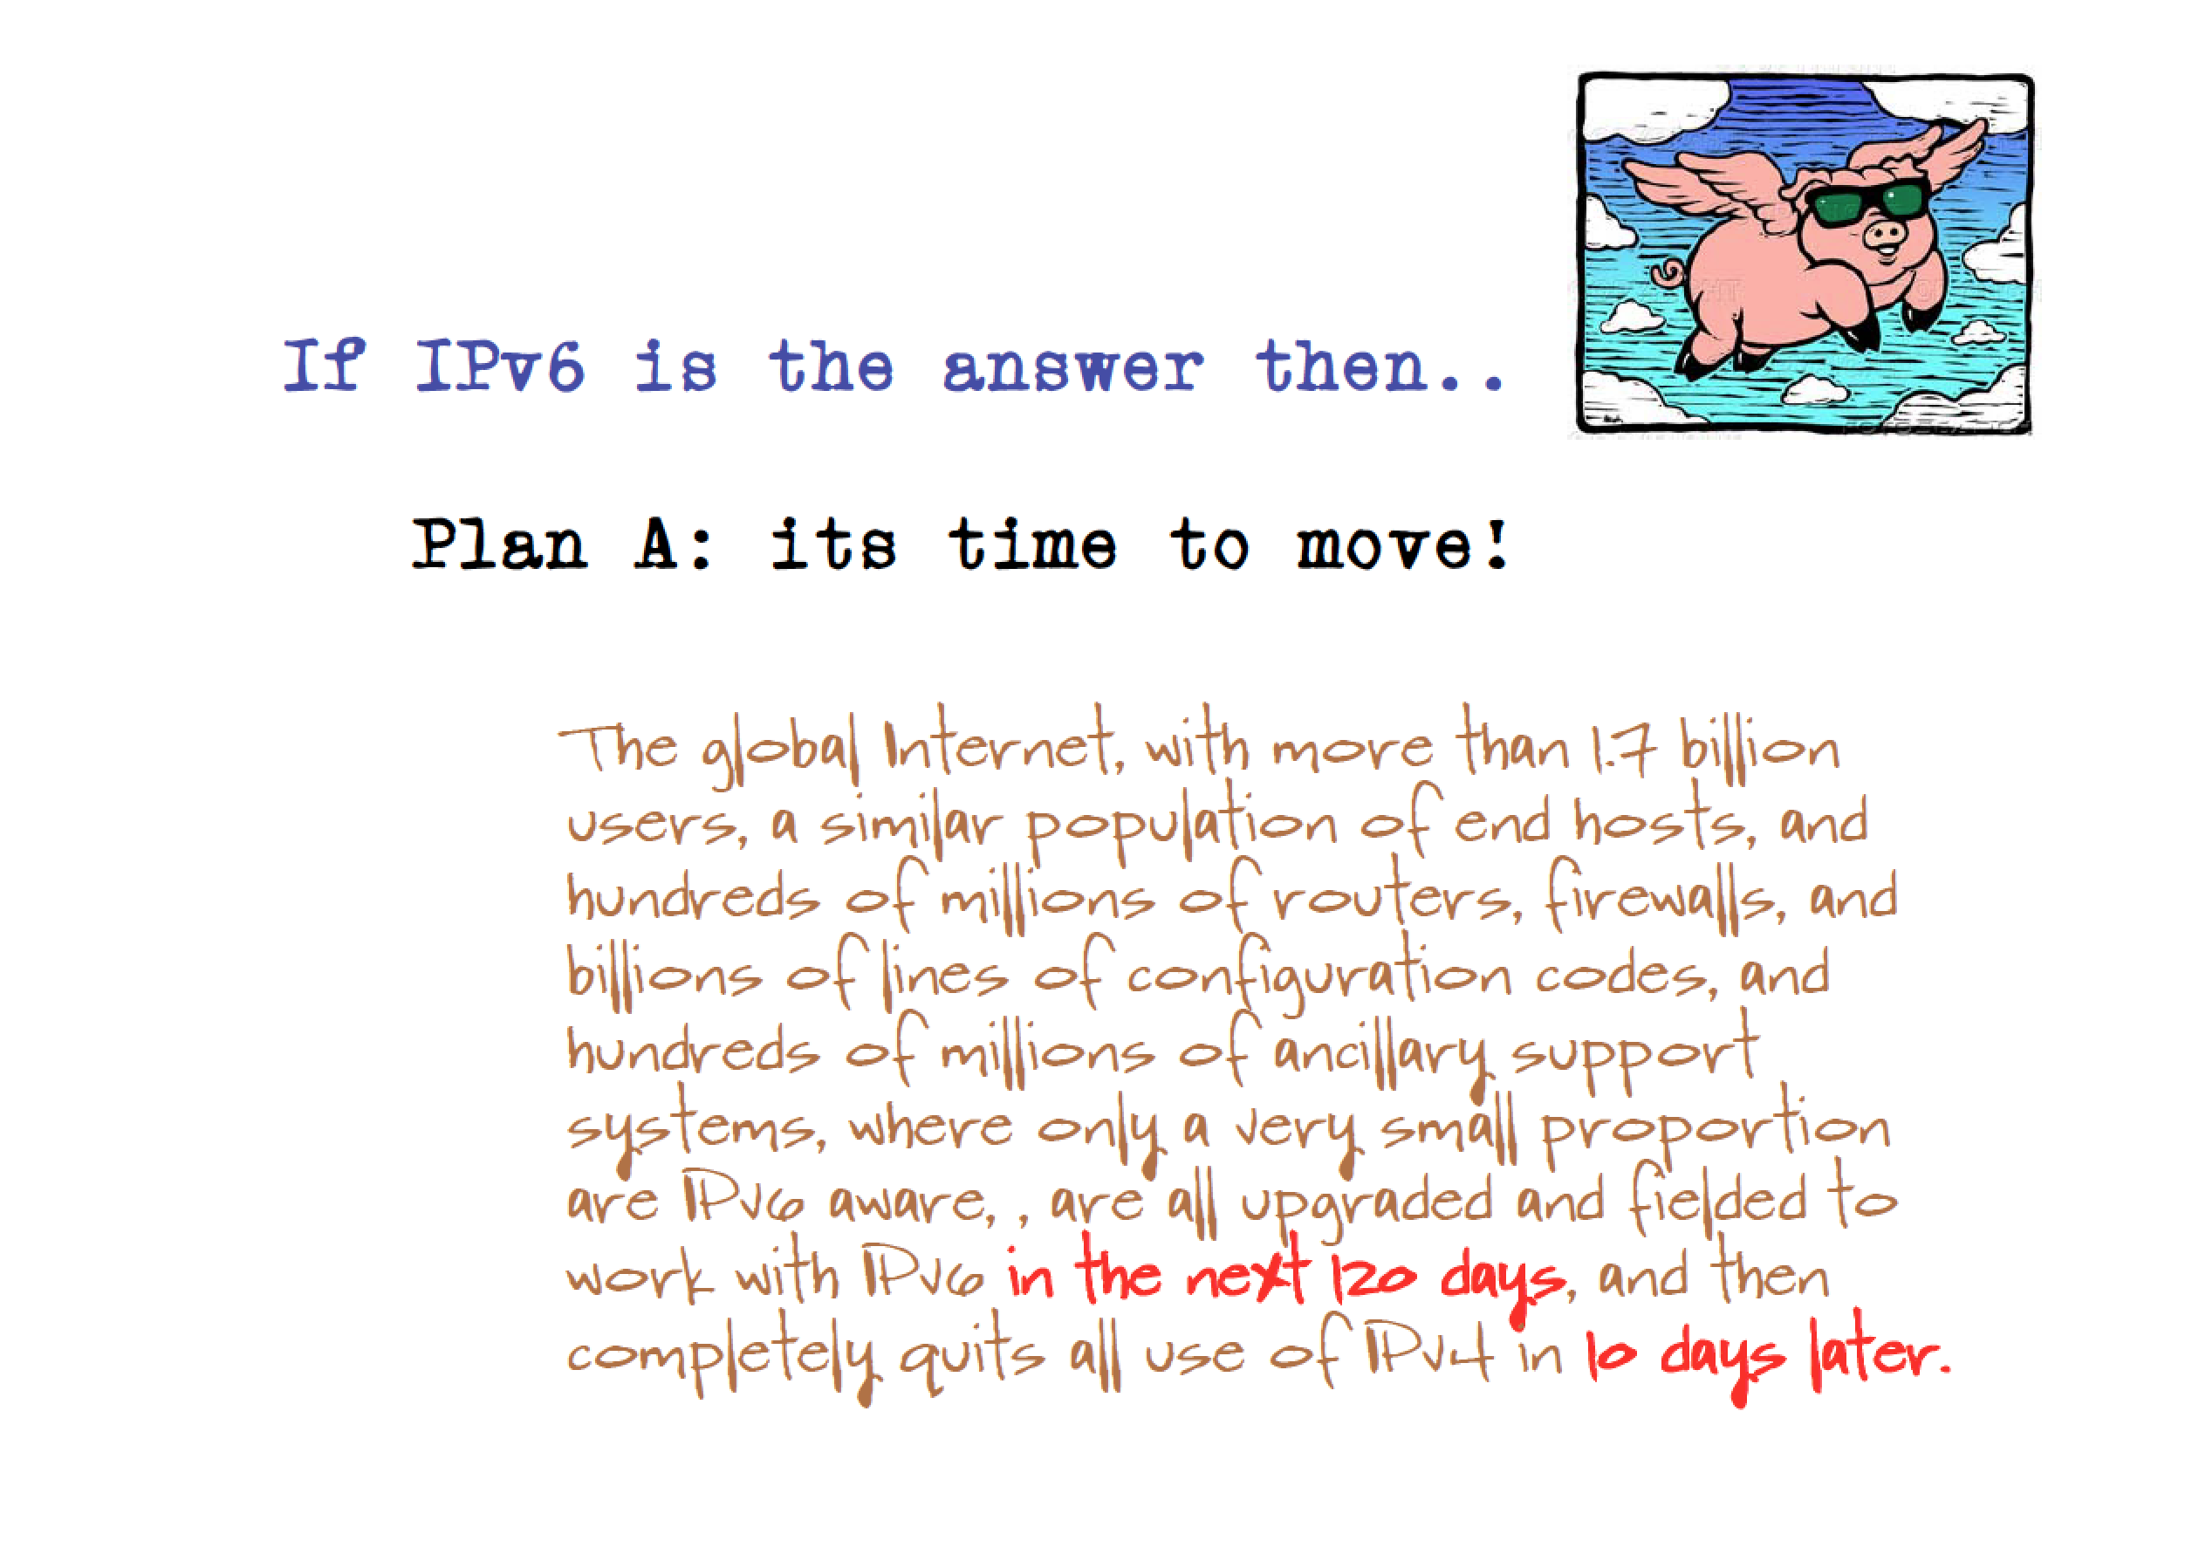

Slide 25


Slide 26


Slide 27
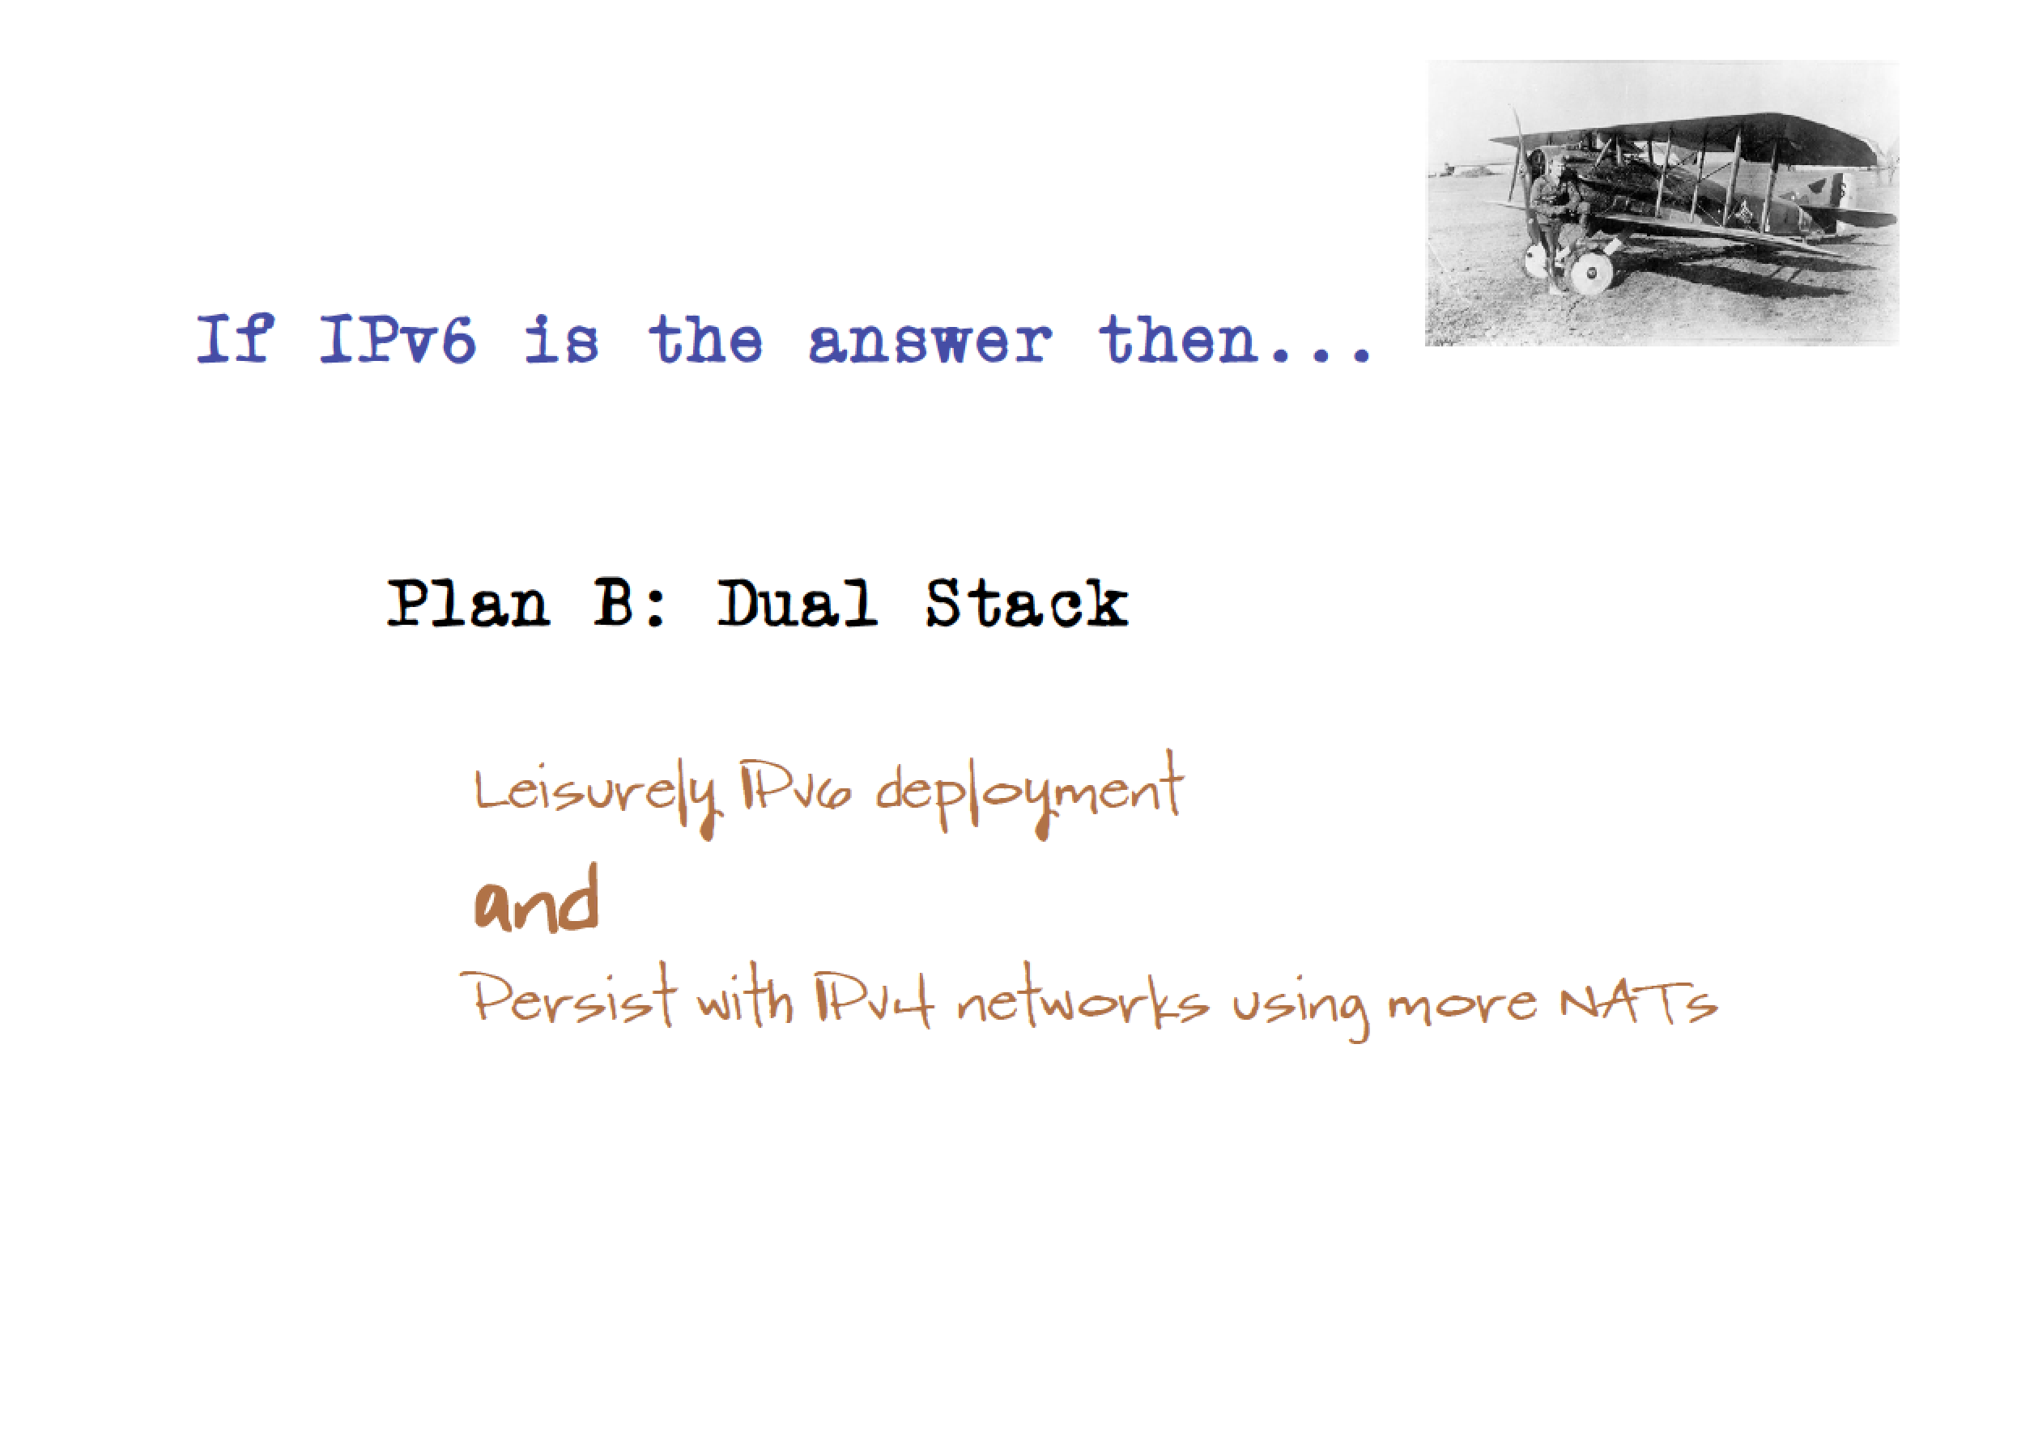

Slide 28
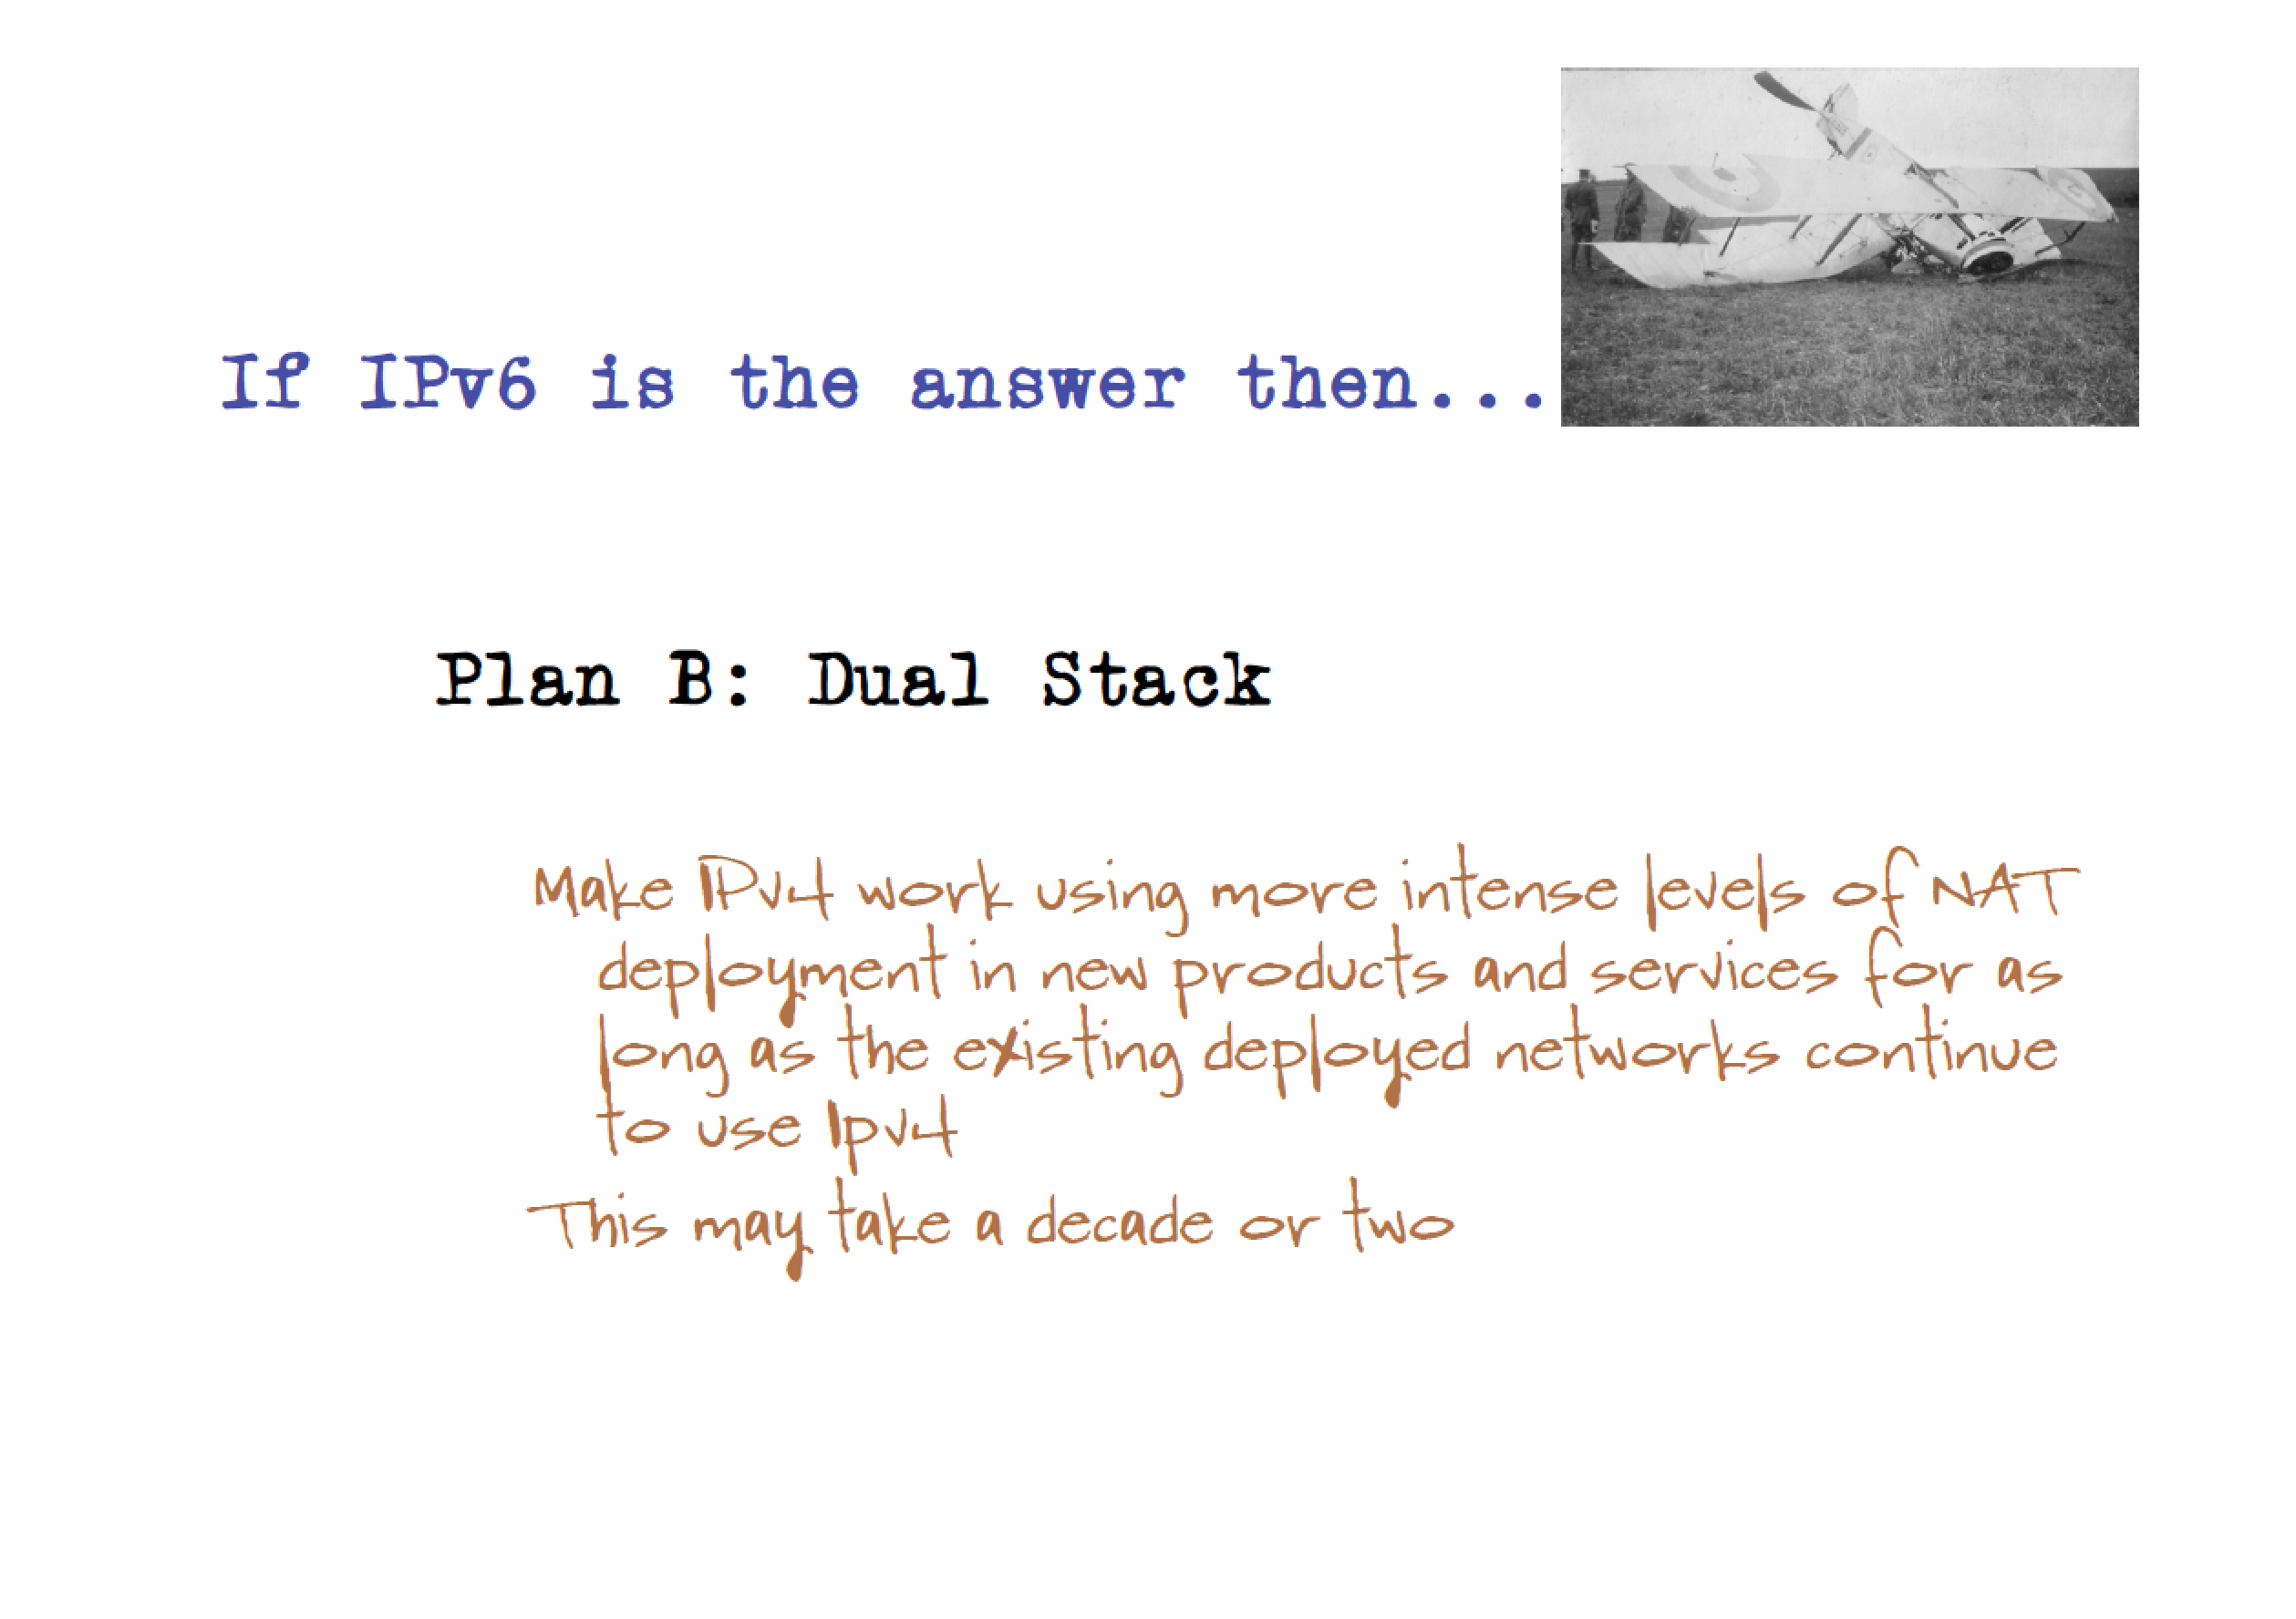

Slide 29


Slide 30


Slide 32
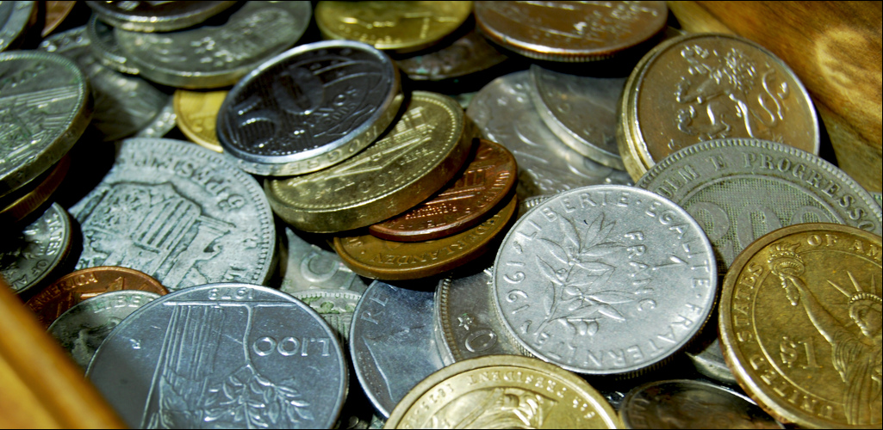
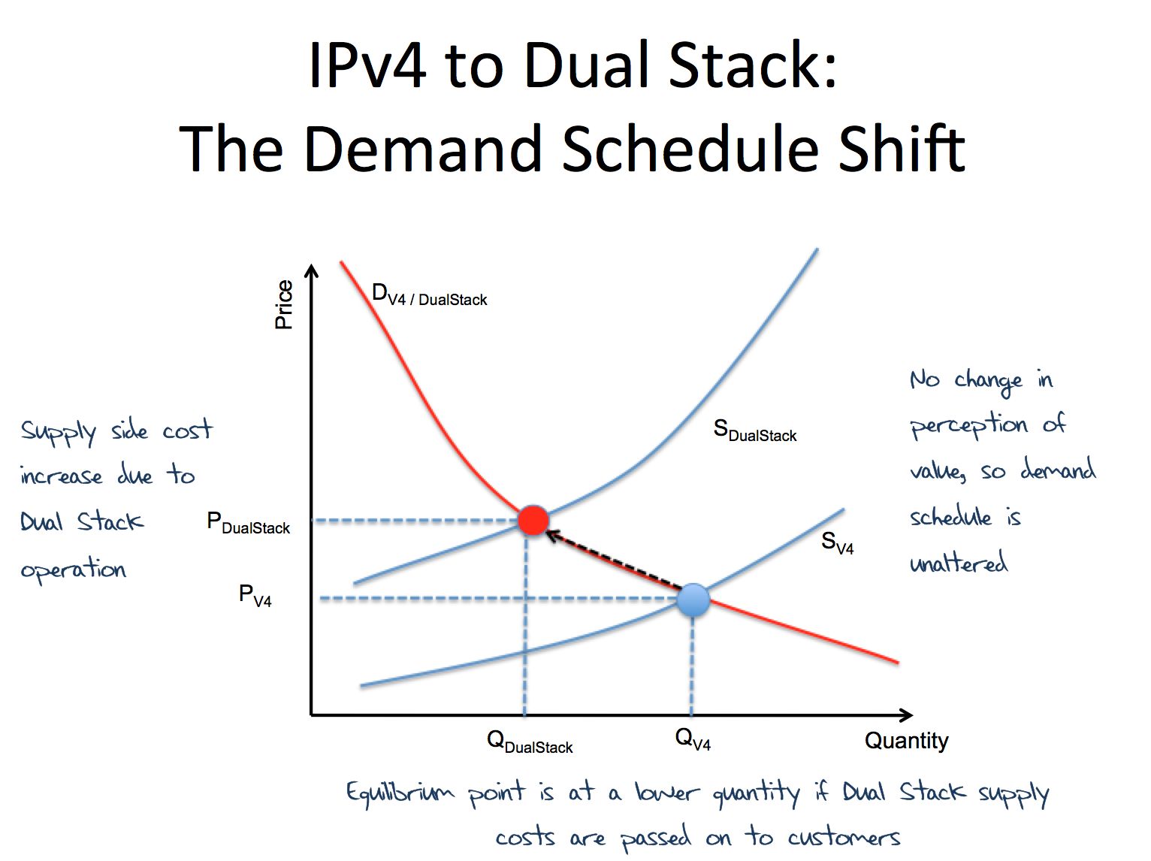
2010 – Invoking Economics!
Background Photo Credit: Flickr: Jose Carlos Norta
https://www.flickr.com/photos/jcarlosn/3890311147/in/photolist-6VLRY8-aP9K9-m6nyiP-4QrV4D-a2YAec-7dzuyM-6PXuwA-MCFr-ca3j71-8QNcE-3PaAeV-62wwVU-4v7QCD-7kuEAk-62LPnT-2rKbM3-5me48g-4yx1S-aoBkR2-5f74Fx-eHeiHt-5WeJBK-895AfY-4qB8yx-kiR87-6oDm6T-58PD49-5tvyLZ-9Gf8D-4NL9XA-6oJkW7-JvyxR-dkGkYb-bqTKak-7pn7Wp-bhYT3r-4SVDTx-85XZwW-e2JW5P-5n8DGR-7d8nZy-CdDhF-4uHGMh-K2kRD-8puuqx-8KzGfS-27RBCn-3fjxP-ppAi-7dUsdb/

Slide 33
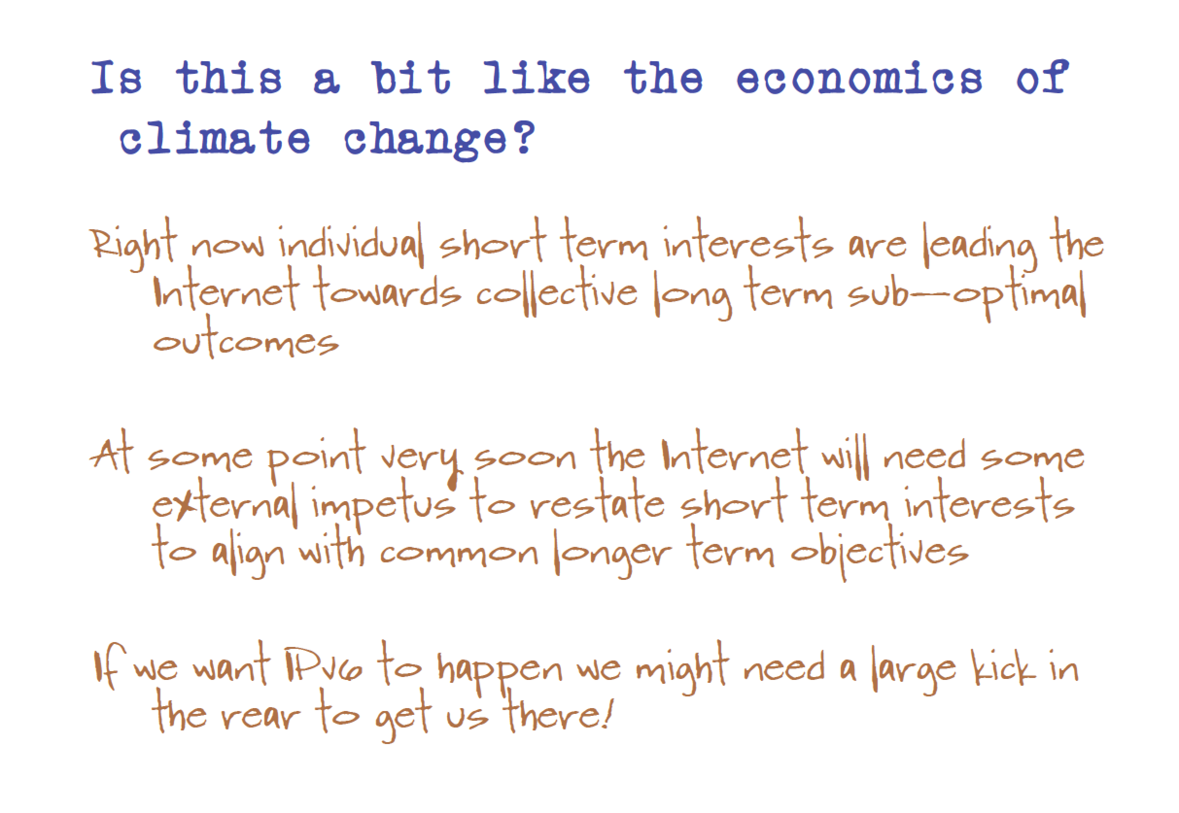
2010 – invoking economics!

Slide 34
Which brings us to…

Slide 35

6 June 2012

Slide 36
World IPv6 Launch
“This time it’s forever”
Urging service providers to turn on IPv6, and leave it on.
Reach out to network, access and content providers to start moving in public on IPv6 services

Slide 37
Did it work?

Slide 38
IPv6 BGP Prefix Count
30,000
World IPv6 Day
15,000
World IPv6 Launch
0
2,000
Jan
2011
Jan
2012
Jan
2013
Jan
2014

Slide 39
Not really.

Slide 40
Where are we today?
Originally we thought that the Internet would avoid complete IPv4 exhaustion and adopt IPv6 before that date
  This has not happened

Slide 41
The RIR IPv4 Address Pools

Slide 42
The RIR IPv4 Address Pools
AFRINIC has at most 2 years to go

Slide 43
So its time …
NATs will work for a while
  But not forever
And after a while
  all that we can do it head towards IPv6
  We have no alternatives left to try

Slide 44
Networks are special
Large scale distributed networks are different
Individual networks need to keep in sync with all of their peer networks
  If a networks heads down its own path it is then isolated
  Isolated networks have little residual value
To keep in sync we need to understand what everyone else is doing
https://www.google.com/intl/en/ipv6/statistics.html

Slide 45
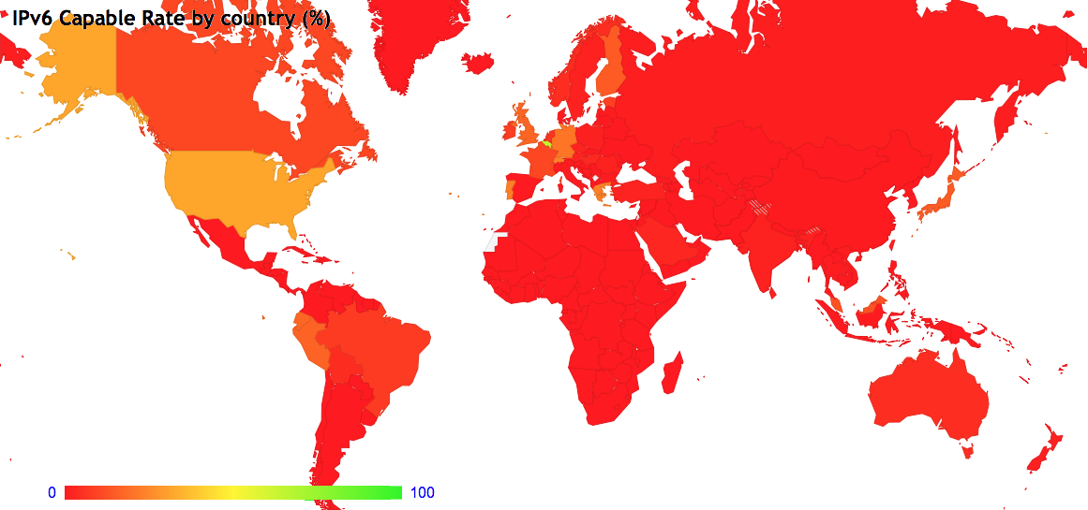
What is everyone doing in IPv6?
http://stats.labs.apnic.net/ipv6

Slide 46
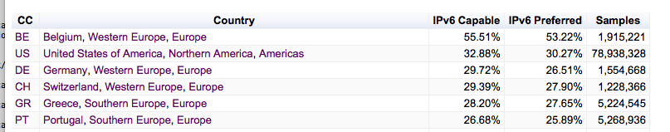
What is everyone doing in IPv6?
http://stats.labs.apnic.net/ipv6

Slide 47
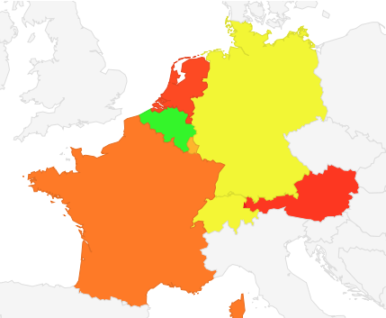
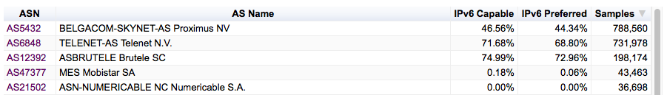
Belgium

Slide 48
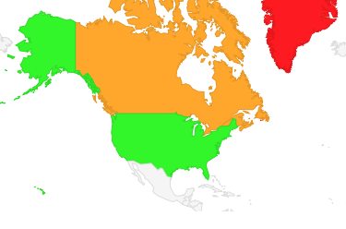
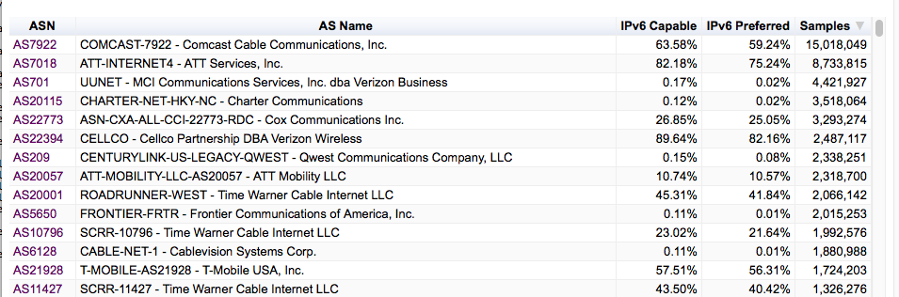
United States

Slide 49
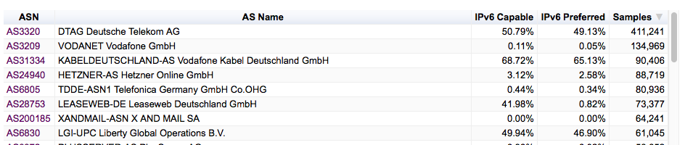
Germany

Slide 50
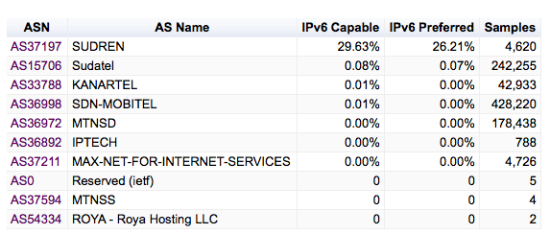
Sudan
AS 37197 – SUDREN has deployed IPv6 – noone else!

Slide 51
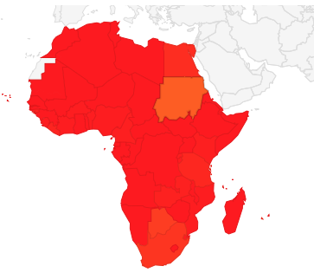
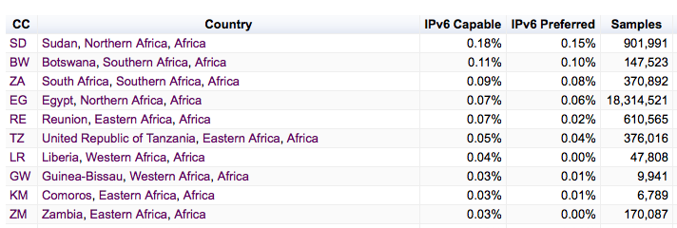
Africa
SUDAN is #1 for IPv6 in Africa!

Slide 52
What are we seeing?
IPv6 deployment is not happening everywhere.
IPv6 is not happening all at once.
But it IS happening.

Slide 53
What are we seeing?
What we appear to be seeing are concentrated areas of quite intense IPv6 activity.

Slide 54
Is IPv6 still “A Waiting Game”?
So far what we have heard from many industry actors about IPv6 is:
“I’m waiting for others. I’ll jump when they jump.”

Slide 55
Is IPv6 still “A Waiting Game”?
In the past year we have seen a number of major commercial network service operators, primarily in the United States, Japan, Germany, France, and Switzerland launch programs that integrate IPv6 services into their mass market retail offerings.

Slide 56
Is IPv6 still “A Waiting Game”?
Is this effort by a few large scale service providers enough to break out of the general waiting game?

Slide 57
Is IPv6 still “A Waiting Game”?
Is this effort by a few large scale service providers enough to break out of the general waiting game?
I’d like to think so!

Slide 58
A question to each of you…
How many IPv6 presentations have you sat through?
21?
101?
1,001?
I don’t know – I was asleep by the end!

Slide 59
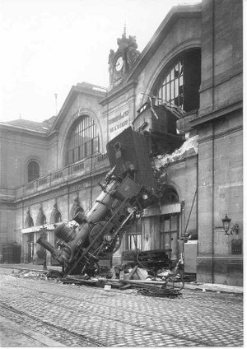
Thank You!

